Slide 1
2022 Cost of Wind Energy Review
Tyler Stehly, Patrick Duffy, and Daniel Mulas Hernando
National Renewable Energy Laboratory
December 2023

Slide 2
Acknowledgments
The authors would like to thank Patrick Gilman (U.S. Department of Energy Office of Energy Efficiency and Renewable Energy Wind Energy Technologies Office [WETO]) for supporting this research. Thanks also to Gage Reber (contractor to WETO) and Daniel Beals of Allegheny Science and Technology (contractor to WETO) for reviewing prior versions of this presentation. Thank you to Ryan Wiser and Mark Bolinger (Lawrence Berkeley National Laboratory) and Alice Orrell (Pacific Northwest National Laboratory) for their analysis of wind project market data that informed this analysis. Thanks also to Philipp Beiter, Eric Lantz, Rob Hammond, Aubryn Cooperman, Matt Shields, Owen Roberts, and Annika Eberle (National Renewable Energy Laboratory) for their technical guidance and Amy Brice (National Renewable Energy Laboratory) for editing the presentation. Any remaining errors or omissions are the sole responsibility of the authors.

Slide 3
List of Acronyms
AEP annual energy production
ATB Annual Technology Baseline
BOS balance of system
CapEx capital expenditures
COD commercial operations date
CRF capital recovery factor
CSM Cost and Scaling Model
DOE U.S. Department of Energy
DW distributed wind
FCR fixed charge rate
FY fiscal year
GPRA Government Performance and Results Act
GW gigawatt
HH hub height
IEC International Electrotechnical Commission
kW kilowatt
LandBOSSE Land-based Balance of System Systems Engineering
LCOE levelized cost of energy
m meter
m/s meters per second
MACRS Modified Accelerated Cost Recovery System
MW megawatt
MWh megawatt-hour
NCF net capacity factor
NP name plate
NREL National Renewable Energy Laboratory
O&M operations and maintenance
OpEx operational expenditures
ORCA Offshore Wind Regional Cost Analyzer
PTC production tax credit
RD rotor diameter
USD U.S. dollars
WACC weighted average cost of capital
WETO Wind Energy Technologies Office
yr year

Slide 4
Executive Summary

Slide 5
Executive Summary
The 12th annual Cost of Wind Energy Review, now presented as a slide deck, uses representative utility-scale and distributed wind energy projects to estimate the levelized cost of energy (LCOE) for land-based and offshore wind power plants in the United States.
Data and results are derived from 2022 commissioned plants, representative industry data, and state-of-the-art modeling capabilities.
The goals of this analysis are to provide insight into current component-level costs and give a basis for understanding the variability in wind energy LCOE across the country.
The primary elements of this 2022 analysis include:
Estimated LCOE for (1) a representative land-based wind energy project installed in a moderate wind resource in the United States, (2) a representative fixed-bottom offshore wind energy project installed in the U.S. North Atlantic, and (3) a representative floating offshore wind energy project installed off the U.S. Pacific Coast
Updated LCOE estimates for representative residential-, commercial-, and large-scale distributed wind projects installed in a moderate wind resource in the United States
Sensitivity analyses showing the range of effects that basic LCOE variables could have on the cost of wind energy for land-based and offshore wind projects
Updated Fiscal Year 2023 values for land-based and offshore wind energy used for Government Performance and Results Act (GPRA) reporting and illustrated progress toward established GPRA targets.

Slide 6
Key Inputs and Levelized Cost of Energy Results
Unnamed: 0 | Unnamed: 1 | Land-Based | Offshore | Offshore.1 | Distributed | Distributed.1 | Distributed.2
Parameter | Units | Utility Scale | Utility Scale (Fixed-Bottom) | Utility Scale (Floating) | Single Turbine (Residential) | Single Turbine (Commercial) | Single Turbine (Large)
Wind turbine rating | MW | 3.3 | 12.0 | 12.0 | 20 (kW) | 100 (kW) | 1.5
Capital expenditures (CapEx) | $/kW | 1,751 | 4,640 | 6,169 | 8,425 | 6,327 | 3,270
Fixed charge rate (FCR) (real) | % | 6.73 | 6.48 | 6.48 | 6.73 | 6.73 | 6.73
Operational expenditures (OpEx) | $/kW/yr | 41 | 109 | 87 | 39 | 39 | 39
Net annual energy production | MWh/MW/yr | 4,100 | 4,295 | 3,346 | 2,580 | 2,846 | 3,326
Levelized cost of energy (LCOE) | $/MWh | 39 | 95 | 145 | 235 | 163 | 78
 |  | Land-Based | Offshore |  | Distributed
Parameter | Units | Utility Scale | Utility Scale (Fixed-Bottom) | Utility Scale (Floating) | Single Turbine (Residential) | Single Turbine (Commercial) | Single Turbine (Large)
Wind turbine rating | MW | 3.3 | 12 | 12 | 20 (kW) | 100 (kW) | 1.5
Capital expenditures (CapEx) | $/kW | 1,750 | 4,640 | 6,169 | 8,425 | 6,327 | 3,270
Fixed charge rate (FCR) (real) | % | 6.73 | 6.48 | 6.48 | 6.73 | 6.73 | 6.73
Operational expenditures (OpEx) | $/kW/yr | 41 | 108 | 87 | 39 | 39 | 39
Net annual energy production | MWh/MW/yr | 4,100 | 4,295 | 3,346 | 2,580 | 2,846 | 3,326
Levelized cost of energy (LCOE) | $/MWh | 39 | 95 | 145 | 235 | 163 | 78
Note: Additional information on the sources of data are presented in the Appendix section. Unless specifically stated, all cost data are reported in 2022 U.S. dollars (USD).
kW = kilowatt; MW = megawatt; MWh = megawatt-hour

Slide 7
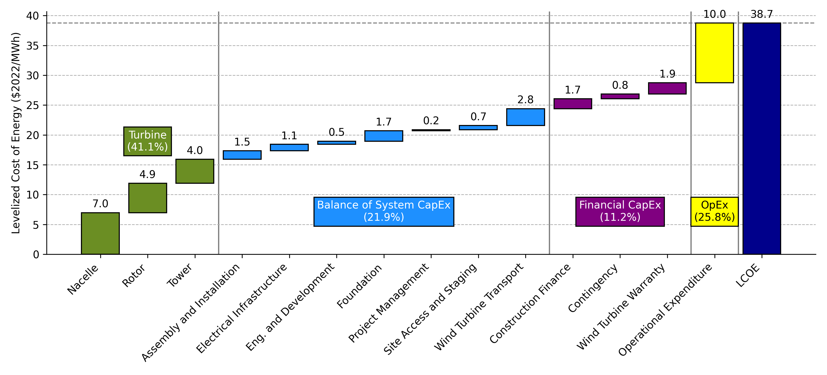
Levelized Cost Breakdown for Reference Land-Based Wind Plant
OpEx (26%)
Turbine CapEx (41%)
Balance of System CapEx (22%)
Soft Cost (11%)
*Cost category also includes insurance, permitting, bonding, and markup estimates

Slide 8
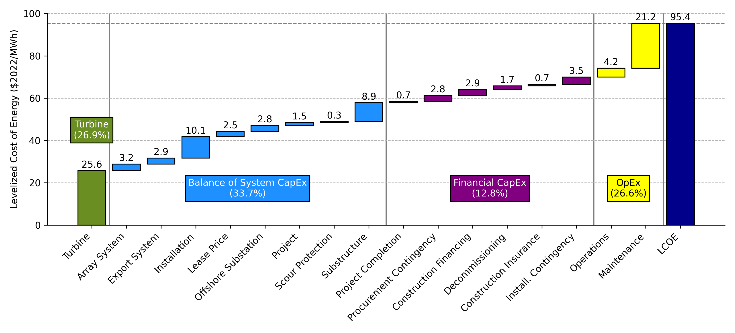
Levelized Cost Breakdown for Reference Fixed-Bottom Offshore Wind Plant
Turbine (27.0%)
Balance of System CapEx (31.9%)
OpEx (26.4%)
Financial CapEx (14.8%)
* Engineering Management cost small, but nonzero

Slide 9
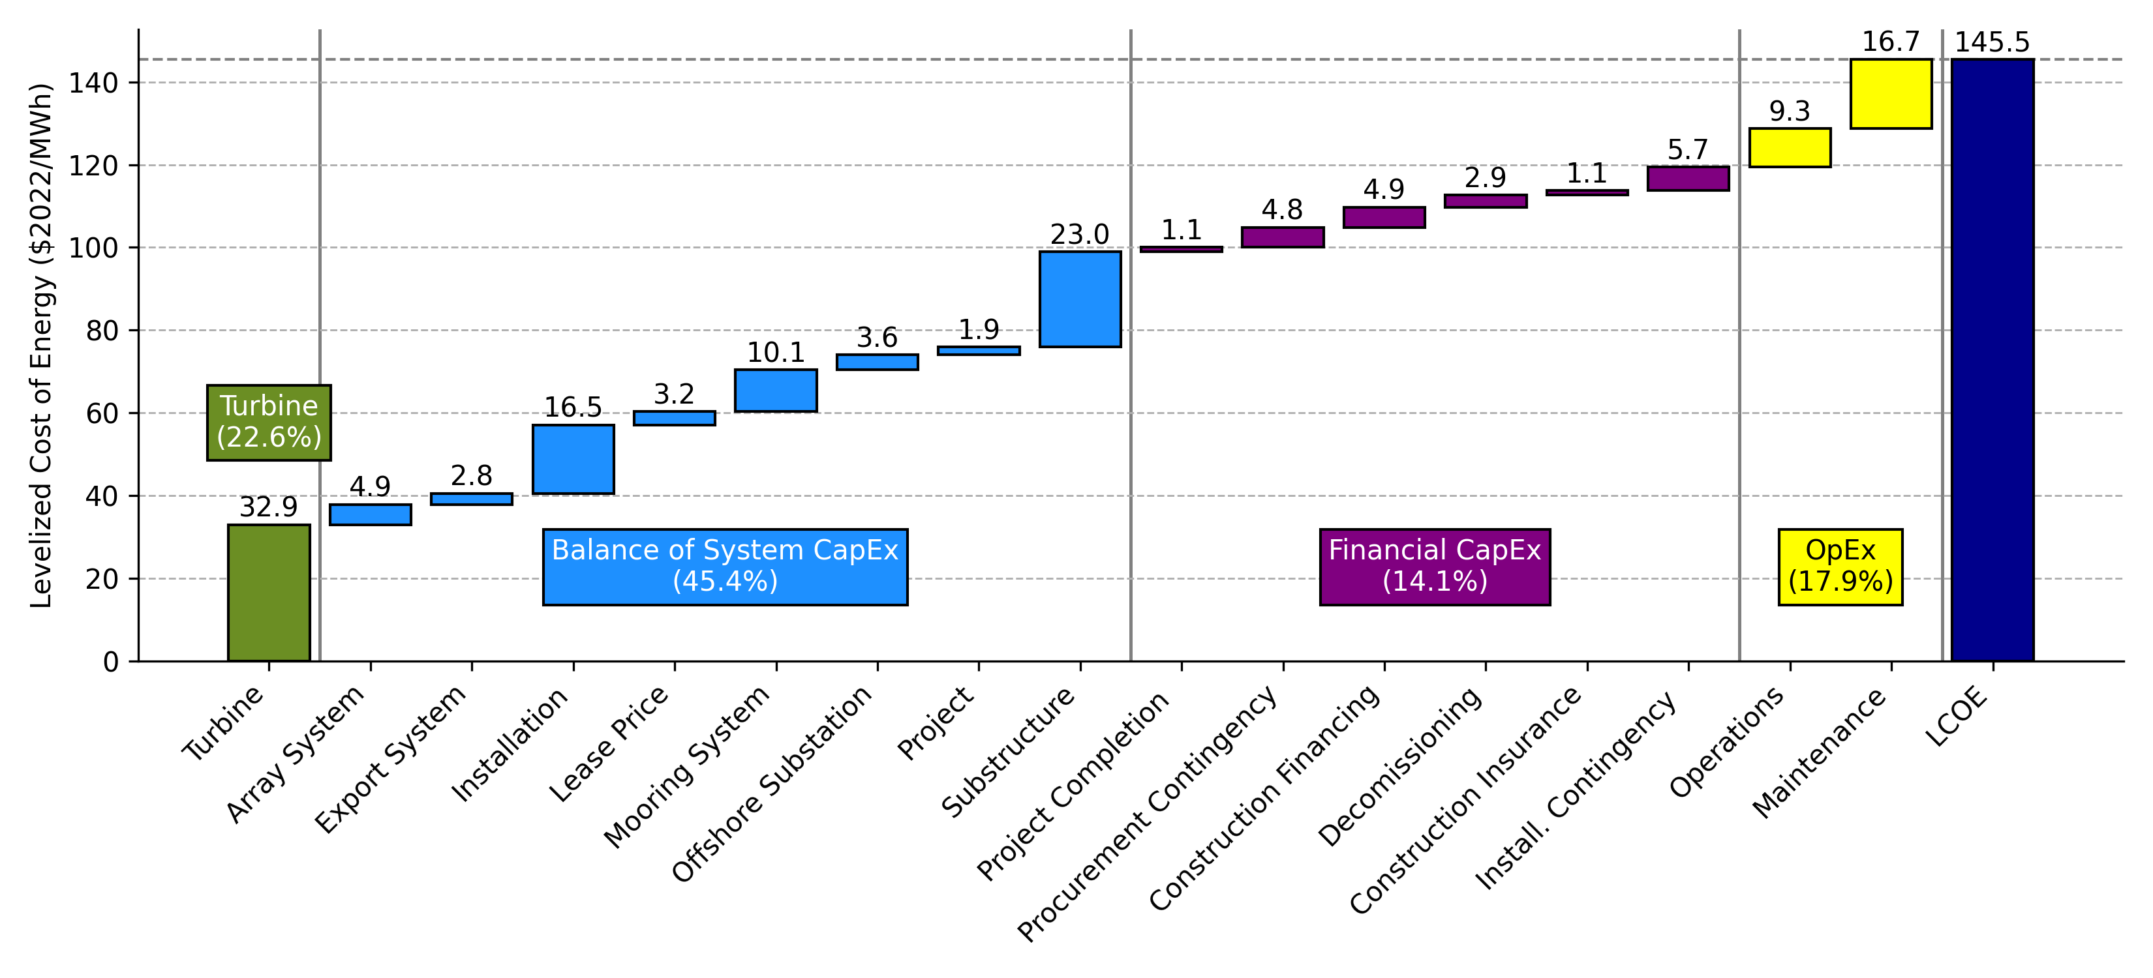
Levelized Cost Breakdown for Reference Floating Offshore Wind Plant
Turbine (22.7%)
OpEx (17.8%)
Financial CapEx (14.1%)
Balance of System CapEx (45.4%)
* Engineering Management cost small, but nonzero

Slide 10
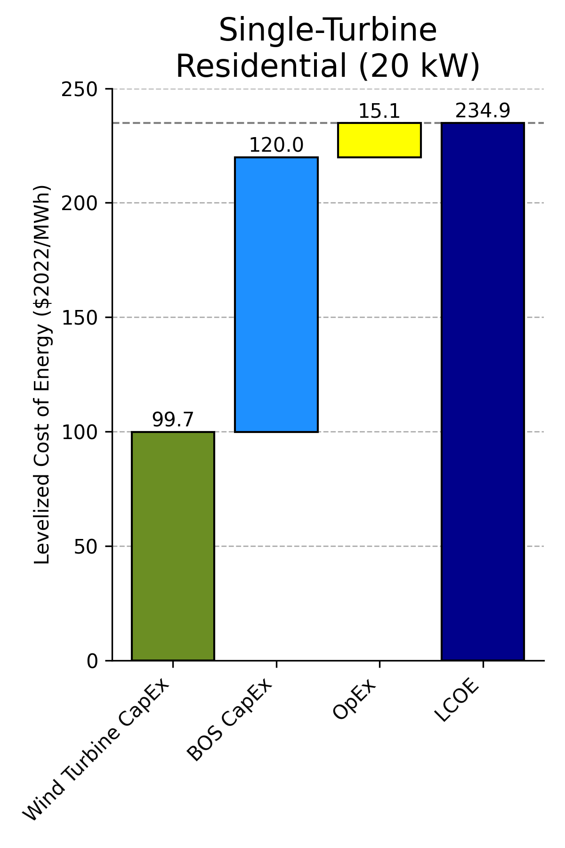
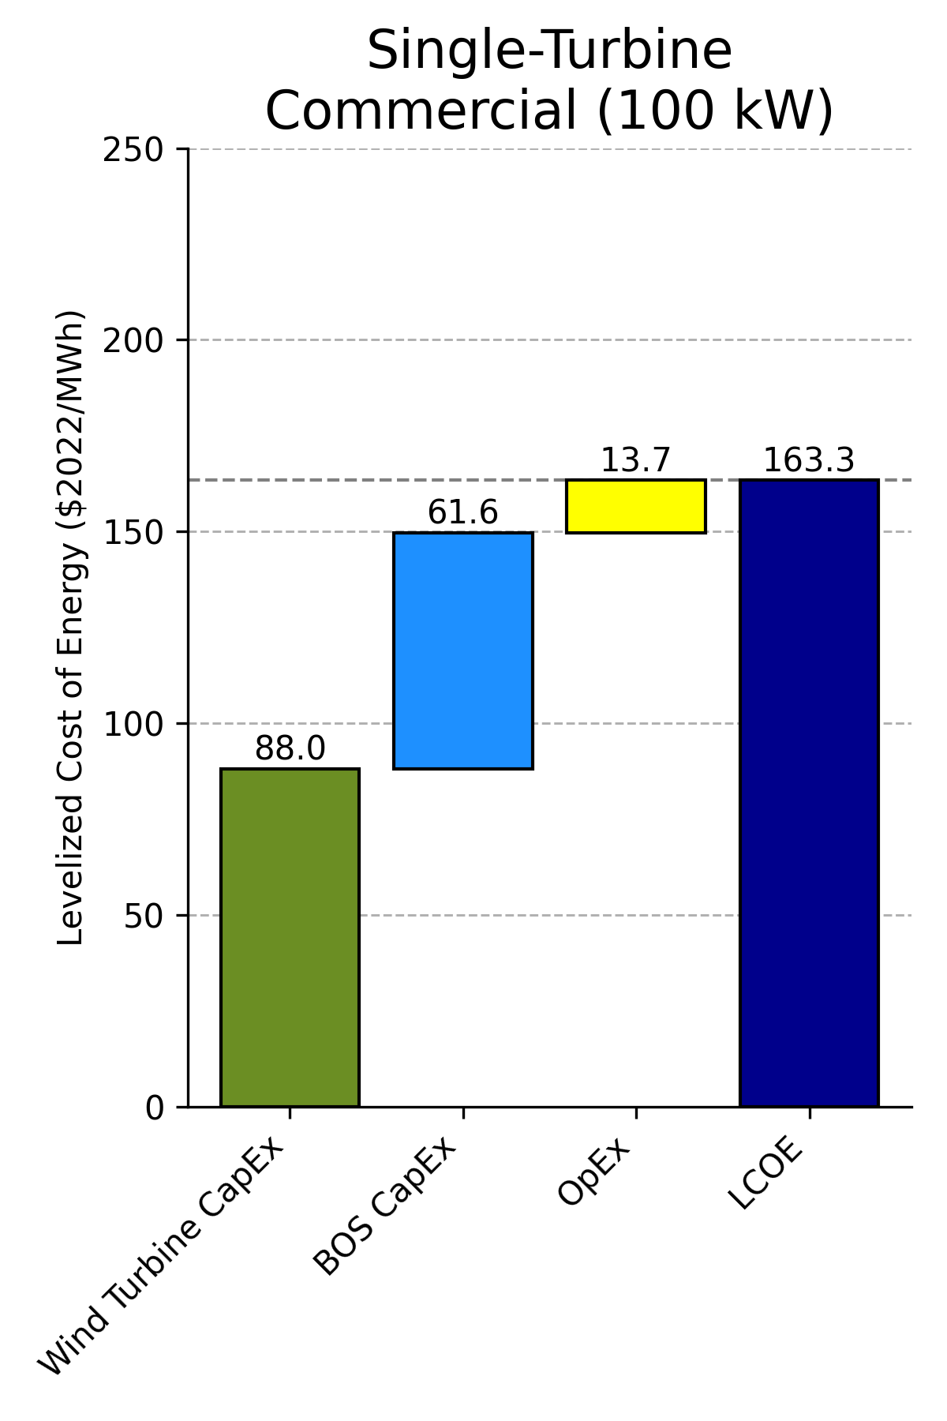
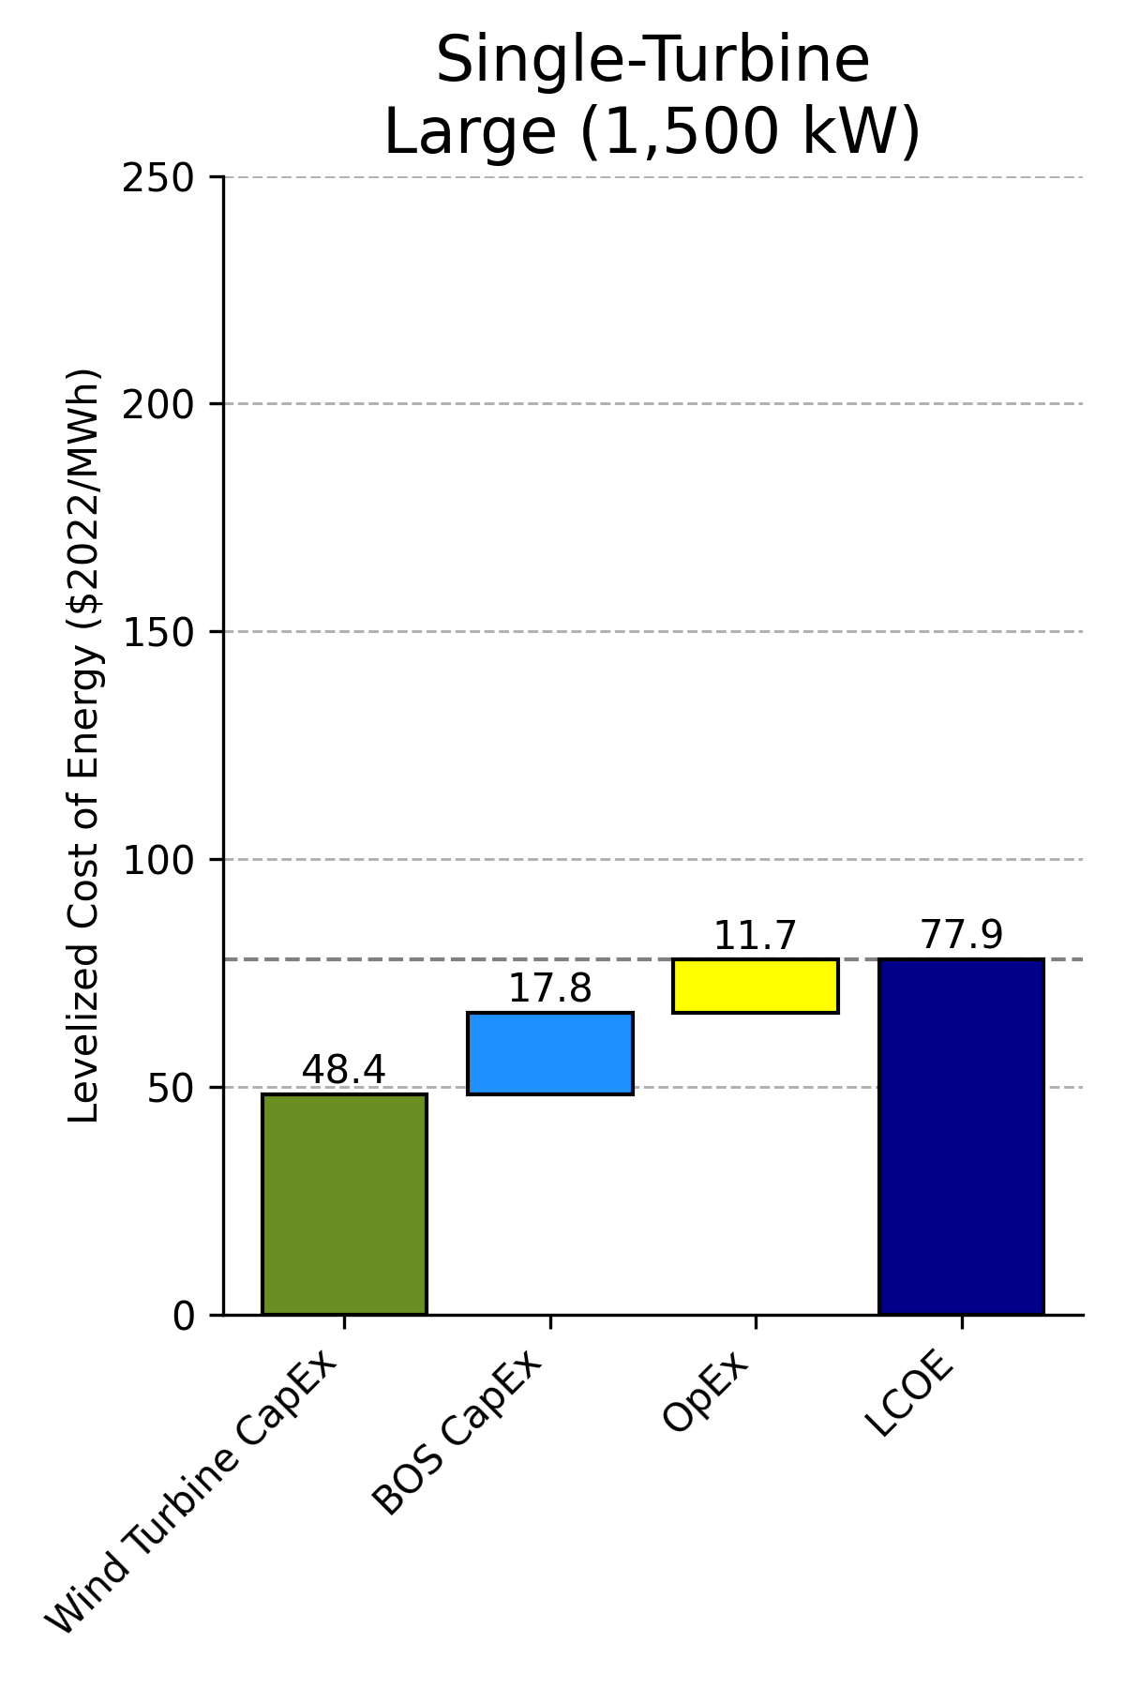
Levelized Cost Breakdown for Reference Distributed Wind Projects
Single-Turbine Residential
(20 kW)
Single-Turbine Commercial
(100 kW)
Single-Turbine Large
(1,500 kW)
BOS = balance of system

Slide 11
Key Conclusions
The reference project LCOE for land-based installations is $39/MWh, with a range of land-based estimates from the single-variable sensitivity analysis covering $30–$59/MWh.
The fixed-bottom offshore wind estimate is $95/MWh, and the floating substructure reference project estimate is $145/MWh. These two reference projects give a single-variable sensitivity range of $55–$170/MWh. This range is primarily caused by the large variation in CapEx ($1,800–$7,711/kW) and project design life.
The residential and commercial reference distributed wind system LCOE are estimated at $235/MWh and $163/MWh, respectively. Single-variable sensitivity analysis for the representative systems is presented in the 2019 Cost of Wind Energy Review (Stehly, Beiter, and Duffy 2020). Analysts included the LCOE estimate for a large distributed wind energy project in this year’s analysis, estimated at $78/MWh.

Slide 12
Background
U.S. Department of Energy Goals and Reporting Requirements
Land-Based Wind Energy
Offshore Wind Energy
Distributed Wind Energy
References
Appendix

Slide 13
1. Background

Slide 14
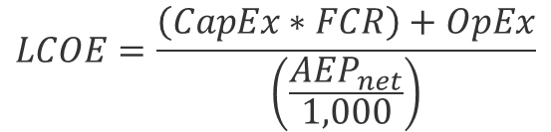
Background
The 2022 Cost of Wind Energy Review estimates the levelized cost of energy (LCOE) for land-based, offshore, and distributed wind energy projects in the United States.
LCOE is a metric used to assess the cost of electricity generation and the total power-plant-level impact from technology design changes and can be used to compare costs of all types of generation.
The specific LCOE method applied in this analysis is described in A Manual for the Economic Evaluation of Energy Efficiency and Renewable Energy Technologies (Short, Packey, and Holt 1995):
LCOE = levelized cost of energy (dollars per megawatt-hour [$/MWh])
FCR = fixed charge rate (%)
CapEx = capital expenditures (dollars per kilowatt [$/kW])
AEP_{net} = net average annual energy production (megawatt-hours per megawatt per year [MWh/MW/yr])
OpEx = operational expenditures ($/kW/yr)
$$LCOE=\frac{\left(CapEx∗FCR\right)+OpEx}{\left(\frac{AEP_{net}}{1,000}\right)}$$

Slide 15
Background
This review also provides an update to the 2021 Cost of Wind Energy Review (Stehly and Duffy 2022) and examines wind turbine costs, financing, and market conditions. The analysis includes:
Estimated LCOE for a representative land-based wind energy project installed in a moderate wind resource (i.e., International Electrotechnical Commission [IEC] wind class IIb [IEC 2020]) in the United States
Estimated LCOE for representative offshore (fixed-bottom and floating) wind energy projects using National Renewable Energy Laboratory (NREL) models and databases of globally installed projects; the authors assessed representative sites on the U.S. North Atlantic Coast (fixed bottom) and Pacific Coast (floating) using current lease and call information, nominations data from the Bureau of Ocean Energy Management, and various geospatial data sets
LCOE estimates for representative residential, commercial, and large distributed wind energy projects in the United States
Sensitivity analyses showing the range of effects that basic LCOE variables could have on the cost of wind energy for land-based and offshore wind power plants
Updates to the national supply curves for land-based and offshore wind energy based on geographically specific wind resource conditions paired with approximate wind turbine size characteristics
Projected land-based and offshore wind cost trajectories from 2022 through 2035 used for U.S. Department of Energy (DOE) annual wind power LCOE reporting as required by the Government Performance and Results Act (GPRA).

Slide 16
2. U.S. Department of Energy Goals and Reporting Requirements

Slide 17
DOE Goals and Reporting Requirements
Every year, the Wind Energy Technologies Office (WETO) reports the LCOE for land-based wind and fixed-bottom offshore wind to satisfy GPRA reporting requirements.
This report provides the underlying market and cost data for WETO to inform the annual GPRA reporting requirements.
Updates to the LCOE targets are periodically implemented to keep performance measures current with developments in the market, incorporate improved cost and performance estimating tools, and reset the dollar year to minimize inflationary pressures on LCOE.
In Fiscal Year (FY) 2023, new GPRA LCOE baseline values, cost reduction trajectories, and end point targets were established for land-based wind and fixed-bottom offshore wind.

Slide 18
GPRA Re-Baseline Efforts Then and Now
The new baseline plant characteristics are a refinement of the previous values and were established using updated bottom-up engineering cost and performance tools, expert wind industry feedback, and analysis from the Annual Technology Baseline.
The new GPRA end-point targets are based on cost reduction trajectories for land-based and fixed-bottom offshore wind projects that span FY 2023 to FY 2035, whereas the previous re-baseline analyses had a target year in FY 2030.
Future re-baseline efforts will be assessed periodically and will be implemented as needed.
The table summarizes the methods and assumptions of the prior GPRA targets and the updated methods and assumptions for the FY 2023 GPRA targets.
 | Land-Based Wind |  | Fixed-Bottom Offshore Wind
Effort | Prior GPRA Baseline (Then) | Re-Baseline (Now) | Prior GPRA Baseline (Then) | Re-Baseline (Now)
Commercial Operation Date | 2015 | 2022 | 2018 | 2022
Technology | Market average turbine parameters | ATB Wind Turbine Technology 3 (3.3 MW, 148 m rotor diameter [RD], 100 m hub height [HH]) (atb.nrel.gov) | Market average turbine parameters | ATB Conservative Scenario (12 MW, 214 m rotor diameter, 136 m hub height) (atb.nrel.gov)
Cost | Market capacity-weighted average (2015 USD) | ATB Conservative Scenario (atb.nrel.gov) | Bottom-up cost modeling + BVG Assoc. innovations reductions (Beiter et al. 2016; Valpy et al. 2017) | CapEx estimated using technology learning similar to ATB (atb.nrel.gov); OpEx and AEP trajectories informed by Wiser et al. (2021)
Finance | Finance model and market data | ATB finance assumptions in R&D case (atb.nrel.gov) | Fixed charge rate method with financing assumptions based on European conditions in 2018 | Fixed charge rate method with financing assumptions based on North American conditions in 2022
Resource | 7.25 m/s @ 50 m above the ground | 7.25 m/s @ 50 m above the ground | 8.43 m/s @ 50 m above the surface | 8.43 m/s @ 50 m above the surface
Performance | 40% (16.7% total losses) | 46.8% (18.9% total losses) | 48.6% (16.2% total losses) | 48.7% (16.0% total losses)

Slide 19
Government Performance and Results Act Cost Reduction Pathway From 2023 to 2035 for Land-Based Wind
Net 32% CapEx reduction through wind plant economies of scale, turbine scaling with less material use, and efficient manufacturing
Net 0% change in energy production
Net 31% OpEx reduction through wind plant economies of scale, turbine scaling, and advanced operations and maintenance (O&M) strategies
The FY 2023 baseline assumes a representative 3.3 MW–148 m (RD)–100 m (HH) wind turbine and the FY 2035 target assumes a 6 MW–170 m (RD)–115 m (HH) wind turbine.
The land-based wind GPRA baseline value starts at $39/MWh (in 2022 USD) set in FY 2023, using the 2022 reference project data.
The land-based wind GPRA target is $27/MWh by FY 2035 (in 2022 USD) and is derived from the analysis conducted in the 2023 Annual Technology Baseline (ATB): atb.nrel.gov.

Slide 20
Government Performance and Results Act Cost Reduction Pathway From 2023 to 2030 for Fixed-Bottom Offshore Wind
Net 38% CapEx reduction through wind plant economies of scale, turbine scaling, and export/array cables with less material use and an optimized foundation design
Net 5% increase in AEP through turbine scaling, enhanced control strategies, reduced wind plant losses, and higher availability because of improved vessel access
Net 17% OpEx reduction from advanced O&M strategies, improved vessel accessibility, and remote maintenance strategies
The GPRA baseline value starts at $95/MWh (in 2022 USD) set in FY 2023 using 2022 reference project data.
The GPRA target is $61/MWh by FY 2035 (commercial operations date [COD] 2034) (in 2022 USD) and is derived for a fixed-bottom wind plant at the reference site based on cost reductions informed by industry learning (Shields et al. 2022) and expert elicitation (Wiser et al. 2021).

Slide 21
Modeled Cost Reduction Pathway From 2023 to 2035 for Floating Offshore Wind Energy
Net 5% increase in energy production through turbine scaling, enhanced control strategies, reduced wind plant losses, and higher availability because of improved vessel access
Net 51% CapEx reduction through wind plant economies of scale, turbine scaling, and export/array cables with less material use and an optimized foundation design
Net 26% OpEx reduction from advanced O&M strategies, improved vessel accessibility, and remote maintenance strategies
DOE has no official GPRA reporting requirement for floating offshore wind energy costs.
Projected floating offshore wind cost reductions are mapped to $74/MWh in FY 2030 using similar methodology as fixed-bottom offshore wind.
DOE established a Floating Offshore Wind Shot goal of $45/MWh (2020 USD) by 2035 for a different reference site using a different set of assumptions.

Slide 22
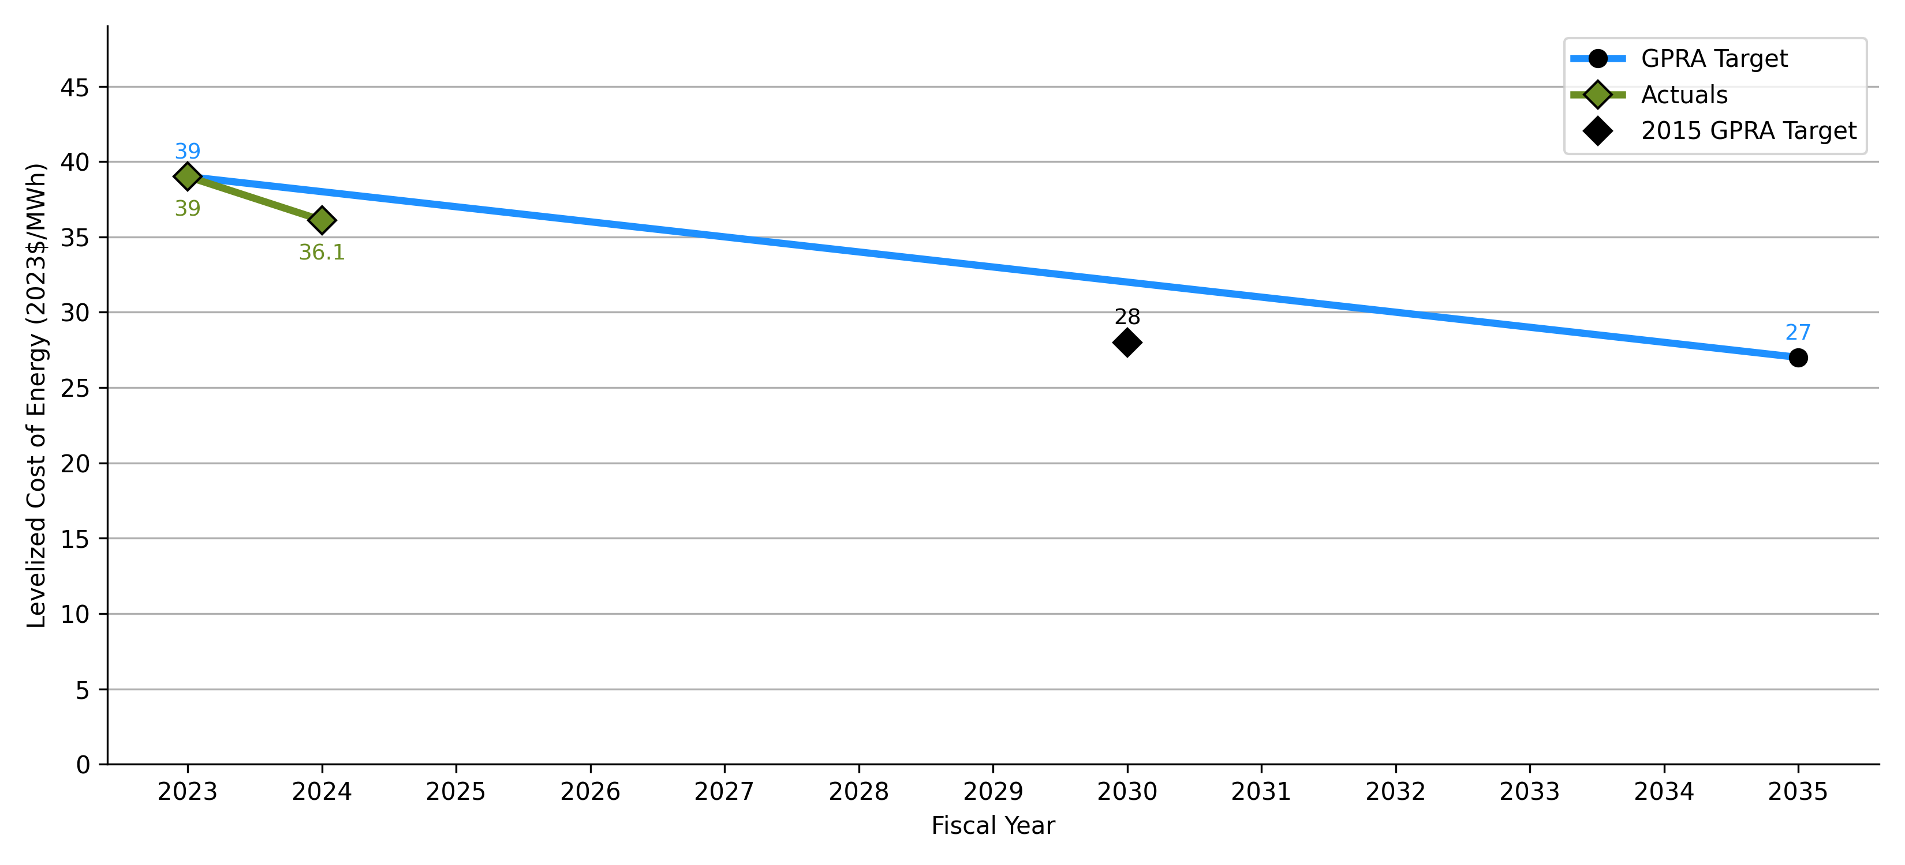
Baseline and GPRA Cost Reduction Pathway From 2023 to 2035 for Land-Based Wind Energy
Updated FY 2023 GPRA Baseline
New FY 2035 GPRA Target
2015 GPRA Target
(for comparison only)
Fiscal year estimates informed by projects with COD the prior year (FY = COD + 1).
The FY 2023 baseline assumes a representative 3.3 MW–148 m (RD)–100 m (HH) wind turbine and the FY 2035 target assumes a 6 MW–170 m (RD)–115 m (HH) wind turbine.
For comparison, the FY 2030 GPRA set in 2015 inflated from 2015 USD to 2022 USD assuming a 23.5% cumulative rate of inflation from the Bureau of Labor and Statistics (undated).
The FY 2023 and FY 2035 LCOE estimates are informed by the analysis conducted in the 2023 Annual Technology Baseline: atb.nrel.gov.

Slide 23
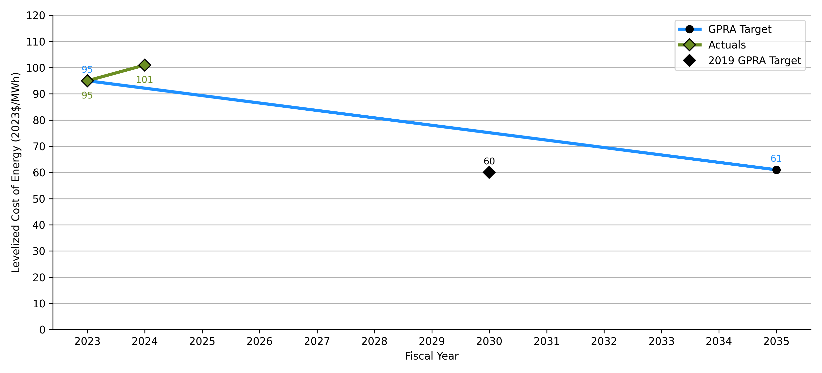
GPRA Cost Reduction Pathway From 2023 to 2035 for Fixed-Bottom Offshore Wind Energy
Updated FY 2023 GPRA Baseline
New FY 2035 GPRA Target
2019 GPRA Target
(for comparison only)
The FY 2023 (COD 2022) LCOE is $95/MWh with an FY 2035 (COD 2034) GPRA target of $61/MWh.
The FY 2030 target is informed by industry learning (Shields et al. 2022) and expert elicitation (Wiser et al. 2021).
For comparison, the FY 2030 GPRA set in 2019 and inflated from 2018 USD to 2022 USD using the Consumer Price Index from the Bureau of Labor and Statistics (undated).

Slide 24
3. Land-Based Wind Energy

Slide 25
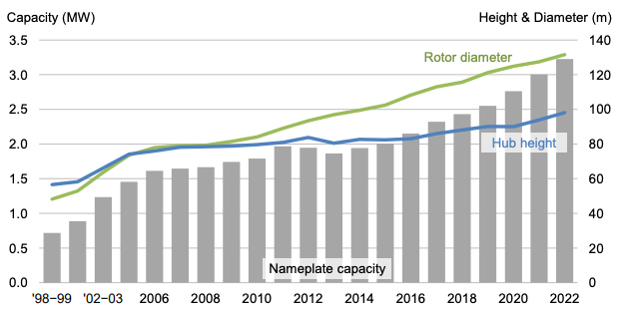
Land-Based Wind Turbine Average Nameplate Capacity, Hub Height, Rotor Diameter, and Assumed Representative Wind Plant
Assumed wind turbine characteristics in 2022 atb.nrel.gov
Parameter | Value
Wind turbine rating | 3.3 MW
Rotor diameter | 148 m
Hub height | 100 m
Wind plant capacity | 200 MW
Number of turbines | 61
Power curve data available on https://github.com/NREL/turbine-models.
Commercial Operations Date
Average turbine nameplate capacity, hub height, and rotor diameter for land-based wind projects
Chart source: Wiser and Bolinger (2023)

Slide 26
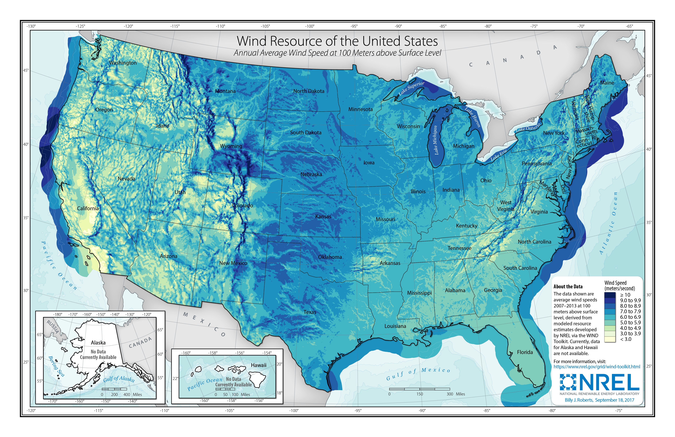
Reference Land-Based Wind Site Characteristics and Performance
Parameter | Value
Annual average wind speed at 50 m above surface level | 7.25 m/s
Annual average wind speed at hub height | 8 m/s
Weibull k | 2.0 (factor)
Shear exponent | 0.14
Gross energy capture | 5,055 MWh/MW/yr
Gross capacity factor | 57.7%
Total losses | 18.9%
Net energy capture | 4,100 MWh/MW/yr
Net capacity factor | 46.8%
Wind resource of the United States, annual average wind speed at 100 m above surface level
Source: NREL (2017)

Slide 27
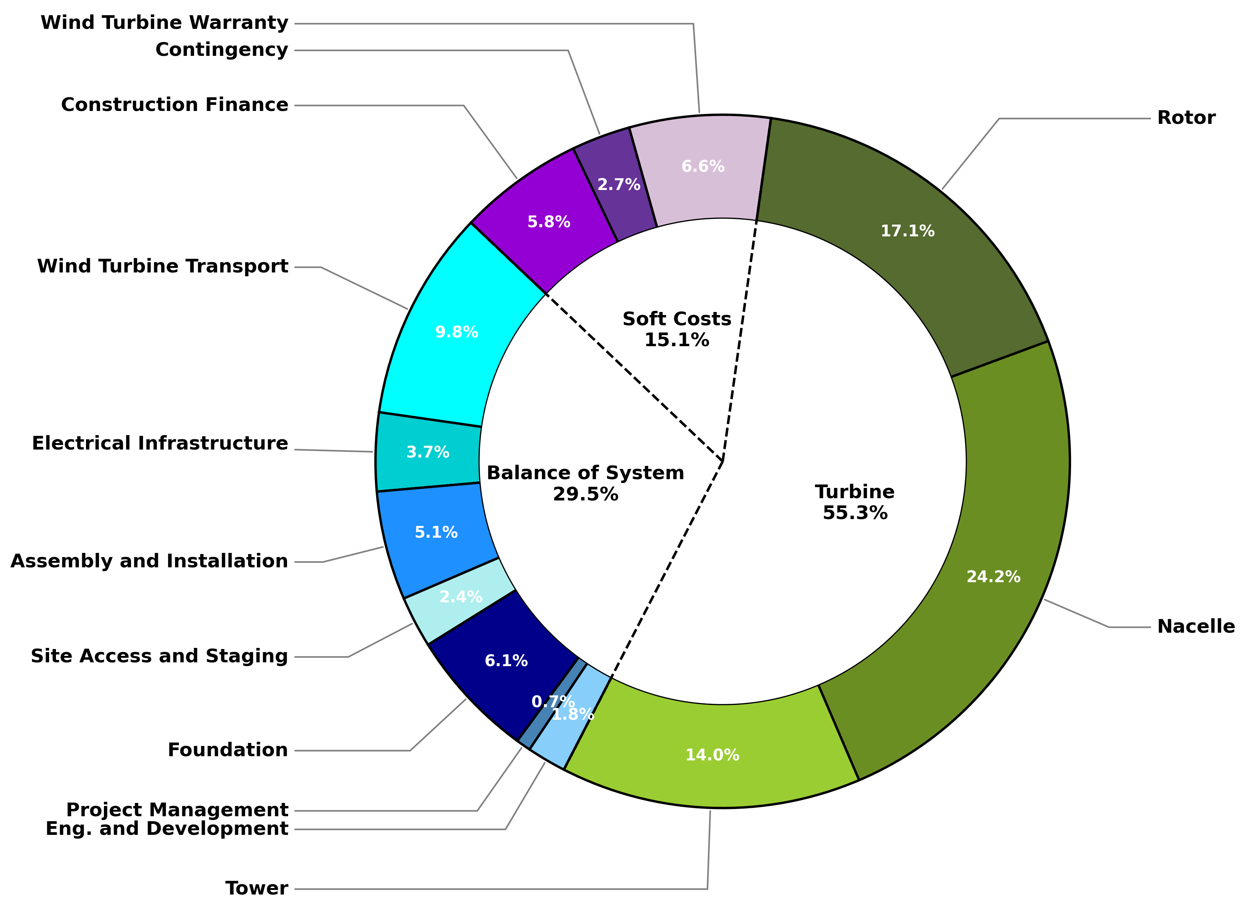
Land-Based Wind Project Component Cost Breakdown
Parameter | Value ($2022/kW)
Total Turbine | 969
Tower | 245
Nacelle | 424
Rotor | 300
Total Balance of System | 517
Wind Turbine Transport | 172
Electrical Infrastructure | 64
Assembly and Installation | 89
Site Access and Staging | 42
Foundation | 106
Project Management | 12
Eng. and Development | 32
Total Soft Costs | 265
Wind Turbine Warranty | 115
Contingency | 48
Construction Finance | 102
Total CapEx | 1,751
Parameter | Value ($/kW)
Wind Turbine CapEx | 969
Rotor | 300
Nacelle | 424
Tower | 245
BOS CapEx | 517
Engineering and development | 32
Project management | 12
Foundation | 106
Site access, staging, and facilities | 42
Assembly and installation | 89
Electrical infrastructure | 64
Wind turbine transport | 172
Soft Cost | 264
Construction finance | 102
Contingency* | 48
Wind turbine warranty | 115
Total CapEx | 1,750
Turbine component cost estimates are derived from recent updates to NREL’s Cost and Scaling Model https://github.com/WISDEM/WISDEM.
BOS component cost estimates are obtained from the Land-based Balance of System Systems Engineering (LandBOSSE) model (Eberle et al. 2019).
Construction financing assumptions are from the 2023 Annual Technology Baseline atb.nrel.gov.
All costs reported in 2022 USD
* Cost category also includes insurance, permitting, bonding, and markup estimates

Slide 28
Relative Value of Manufactured Product Components for the Land-Based Wind Project
Cost of Wind Energy Review Cost Parameter | Manufactured Product Component (U.S. Department of the Treasury 2023) | Contribution to Total Manufactured Product Value for an Industry-Standard Wind Turbine (%)
Wind Turbine CapEx
Rotor | Blades | 31.2 (+3.5% / -4.5%)
 | Rotor hub | 9.9 (+2.1% / -0.5%)
Nacelle | Nacelle (excluding power converter) | 47.5 (+4.5% / -2.5%)
 | Power converter | 8.9 (+1.1% / -2.1%)
Tower | Wind tower flanges | 1.6 (+0.6% / -0.5%)
BOS CapEx
Turbine incorporation and installation | Final onsite manufacturing and installation of wind turbine (excluding tower)* | 0.9 (+0.9%)
In May 2023, the U.S. Department of the Treasury (2023b) released guidance that indicates for a project to qualify for the domestic content bonus under the Inflation Reduction Act, “all manufacturing processes with respect to any steel or iron items that are Applicable Project Components take place in the United States,” and a minimum percentage of the costs of manufactured products and components “are attributable to manufactured products (including components) which are mined, produced, or manufactured in the United States.”
This table breaks down relevant land-based wind project components to show the applicable manufactured product components identified by the U.S. Department of the Treasury (2023a) and provides their relative contribution to the total manufactured product cost.
Manufactured product component cost estimates were developed for a range of wind turbine ratings using empirical data and NREL’s Cost and Scaling Model (https://github.com/WISDEM/WISDEM). As a result, the relative contributions are not specific to the 3.3-MW wind turbine used in this report but are broadly applicable to industry-standard wind turbines. Additional information describing the methodology for developing the manufactured product component data is presented in the Appendix.
* The U.S. Department of the Treasury (2023a) guidance allows direct material and direct labor costs to produce a U.S. manufactured product (here, the wind turbine, excluding the tower) within the total manufactured product cost if all the manufactured product components (e.g., the blades, rotor hub, nacelle, power converter, and tower flanges) are produced in the United States.

Slide 29
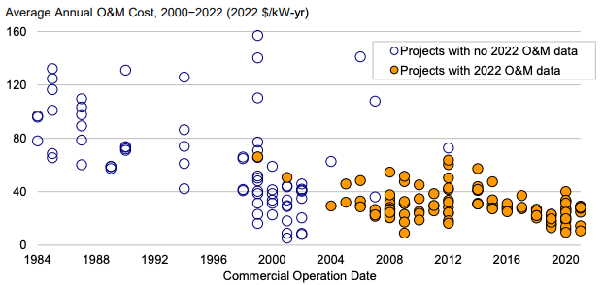
Land-Based Wind Plant Operational Expenditures Estimate and Historical Data
Parameter | Value | Unit
Operational Expenditures | 41.0 | $/kW/yr
Parameter | Value
Estimated OpEx | $41/kW-yr
All-in project OpEx estimates informed by updated analysis conducted in the 2023 Annual Technology Baseline (atb.nrel.gov).
Average O&M costs for available data years from 2000 to 2022, by commercial operation date
Chart source: Wiser and Bolinger (2023)
Note: O&M data reported in the chart do not include all operating costs.

Slide 30
Land-Based Wind Project Financial Assumptions
Parameter | Nominal Value | Real Value
Weighted average cost of capital | 6.57% | 3.97%
Capital recovery factor | 8.25% | 6.38%
Fixed charge rate | 8.7% | 6.73%
The economic evaluation of wind energy investments in this analysis uses the fixed charge rate (FCR) method from NREL’s Annual Technology Baseline and Standard Scenarios web page: atb.nrel.gov.
The FCR represents the amount of annual revenue required to pay the carrying charge as applied to the CapEx on that investment during the expected project economic life and is based on the capital recovery factor (CRF) but also reflects corporate income taxes and depreciation.
The analysis assumes the reference project operates for 25 years, a 5-year Modified Accelerated Cost Recovery System (MACRS) depreciation schedule, and an inflation rate of 2.5%.
Additional financial assumption details are displayed in the Appendix.

Slide 31
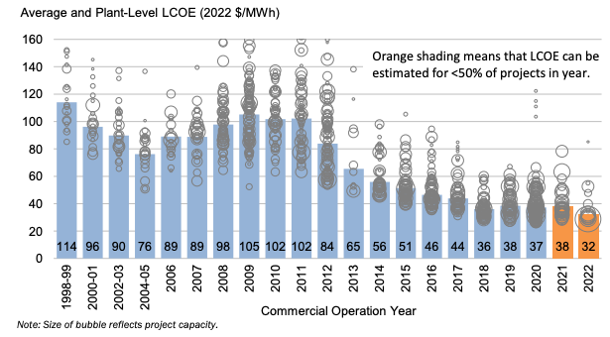
LCOE for Representative Land-Based Wind Plant and Historical Data
Unnamed: 0 | Unnamed: 1 | Land-Based
Parameter | Units | Utility Scale
Wind turbine rating | MW | 3.3
Capital expenditures (CapEx) | $/kW | 1,751
Fixed charge rate (FCR) (real) | % | 6.73
Operational expenditures (OpEx) | $/kW/yr | 41
Net annual energy production | MWh/MW/yr | 4,100
Levelized cost of energy (LCOE) | $/MWh | 39
Parameter | Value
Wind turbine rating | 3.3 MW
Capital expenditures | $1,750/kW
Fixed charge rate (real) | 6.73%
Operational expenditures | $41/kW/yr
Net annual energy production | 4,100 MWh/MW/yr
Calculated levelized cost of energy | $39/MWh
Modeled cost and performance data using the methods presented in the 2023 Annual Technology Baseline (atb.nrel.gov) to calculate LCOE.
Estimated levelized cost of wind energy for actual wind projects by commercial operation date
Chart source: Wiser and Bolinger (2023)

Slide 32
LCOE Breakdown for Reference Land-Based Wind Plant
OpEx (26%)
Turbine CapEx (41%)
Balance of System CapEx (22%)
Soft Cost (11%)
*Cost category also includes insurance, permitting, bonding, and markup estimates

Slide 33
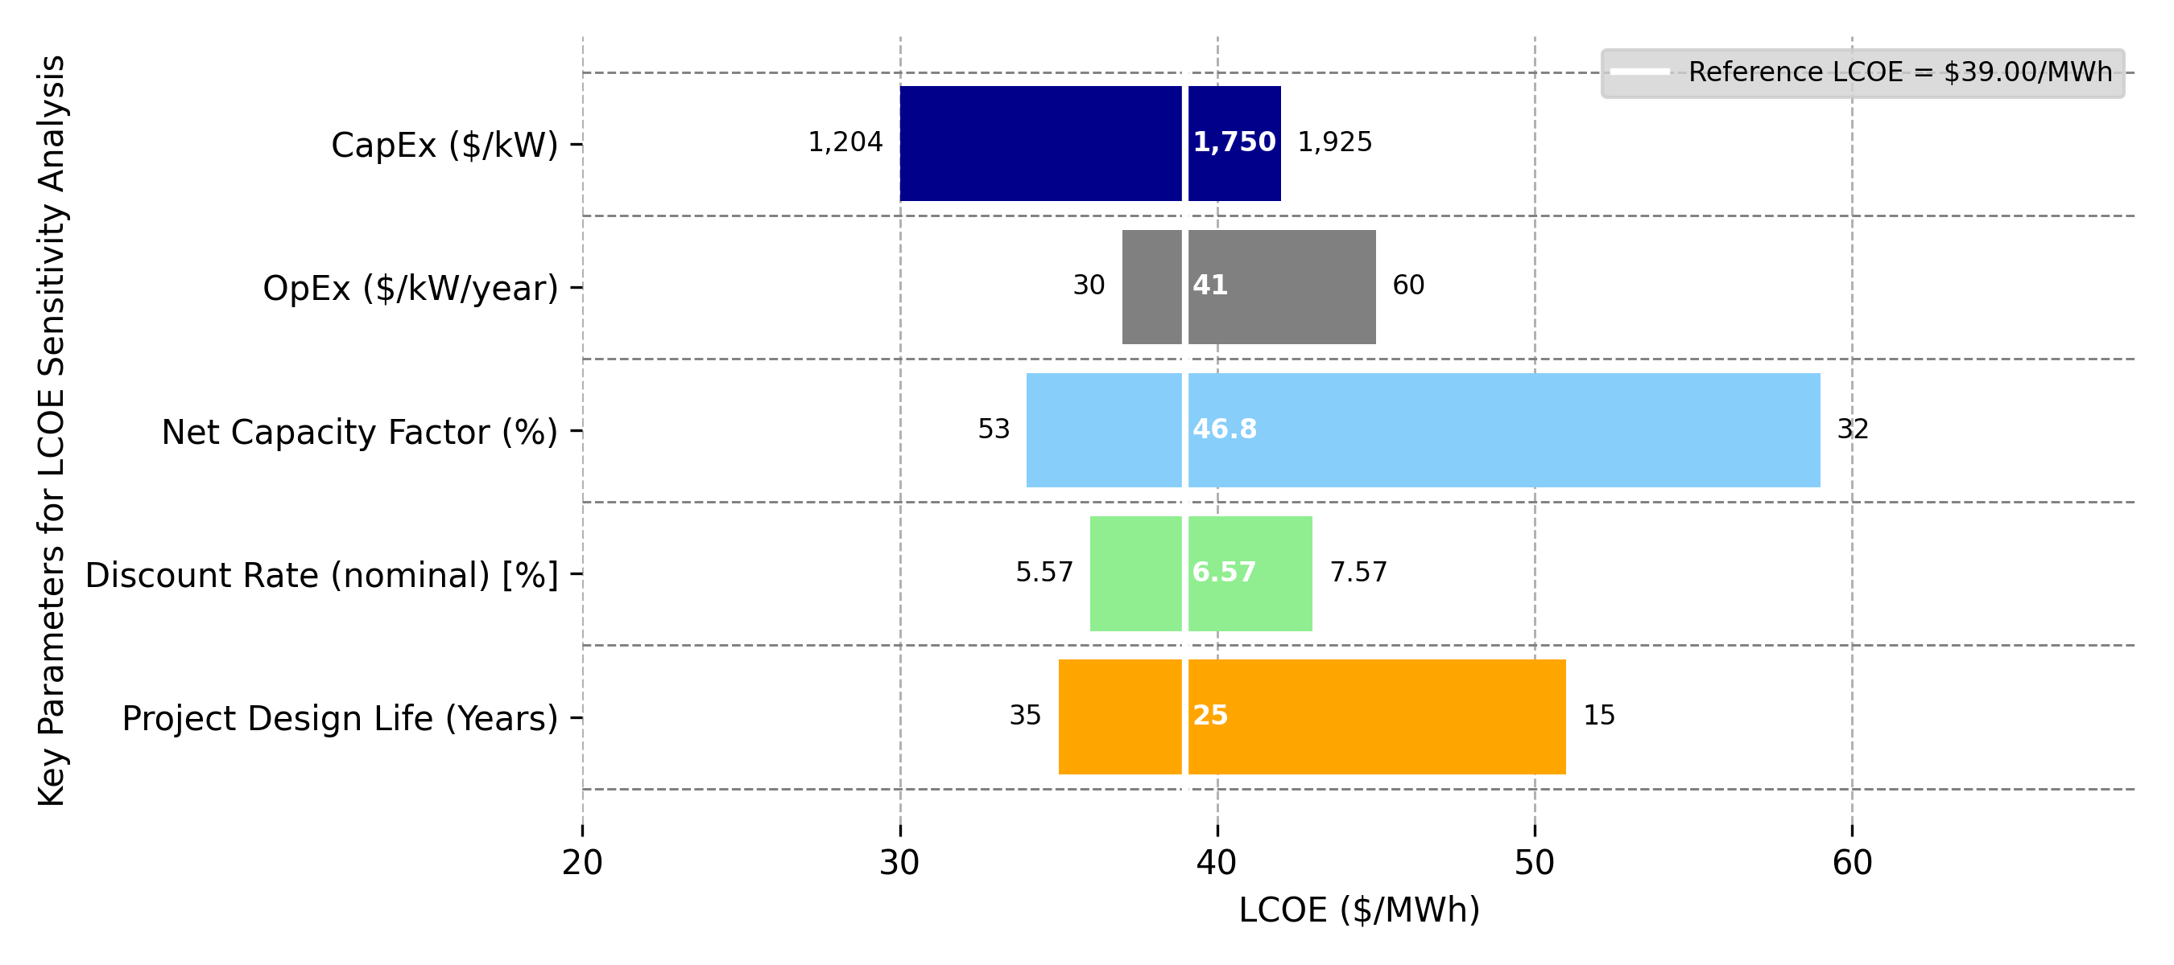
Range of LCOE Parameters for Land-Based Wind
1,204
1,750
1,925
30
41
60
53
46.8
32
Key Parameters for LCOE Sensitivity Analysis
5.57
6.57
7.57
35
25
15
Reference LCOE = $39/MWh
Note: The reference LCOE reflects a representative industry LCOE. Changes in LCOE for a single variable can be understood by moving to the left or right along a specific variable. Values on the x-axis indicate how the LCOE will change as a given variable is altered and all others are assumed constant (i.e., remain reflective of the reference project).

Slide 34
4. Offshore Wind Energy

Slide 35
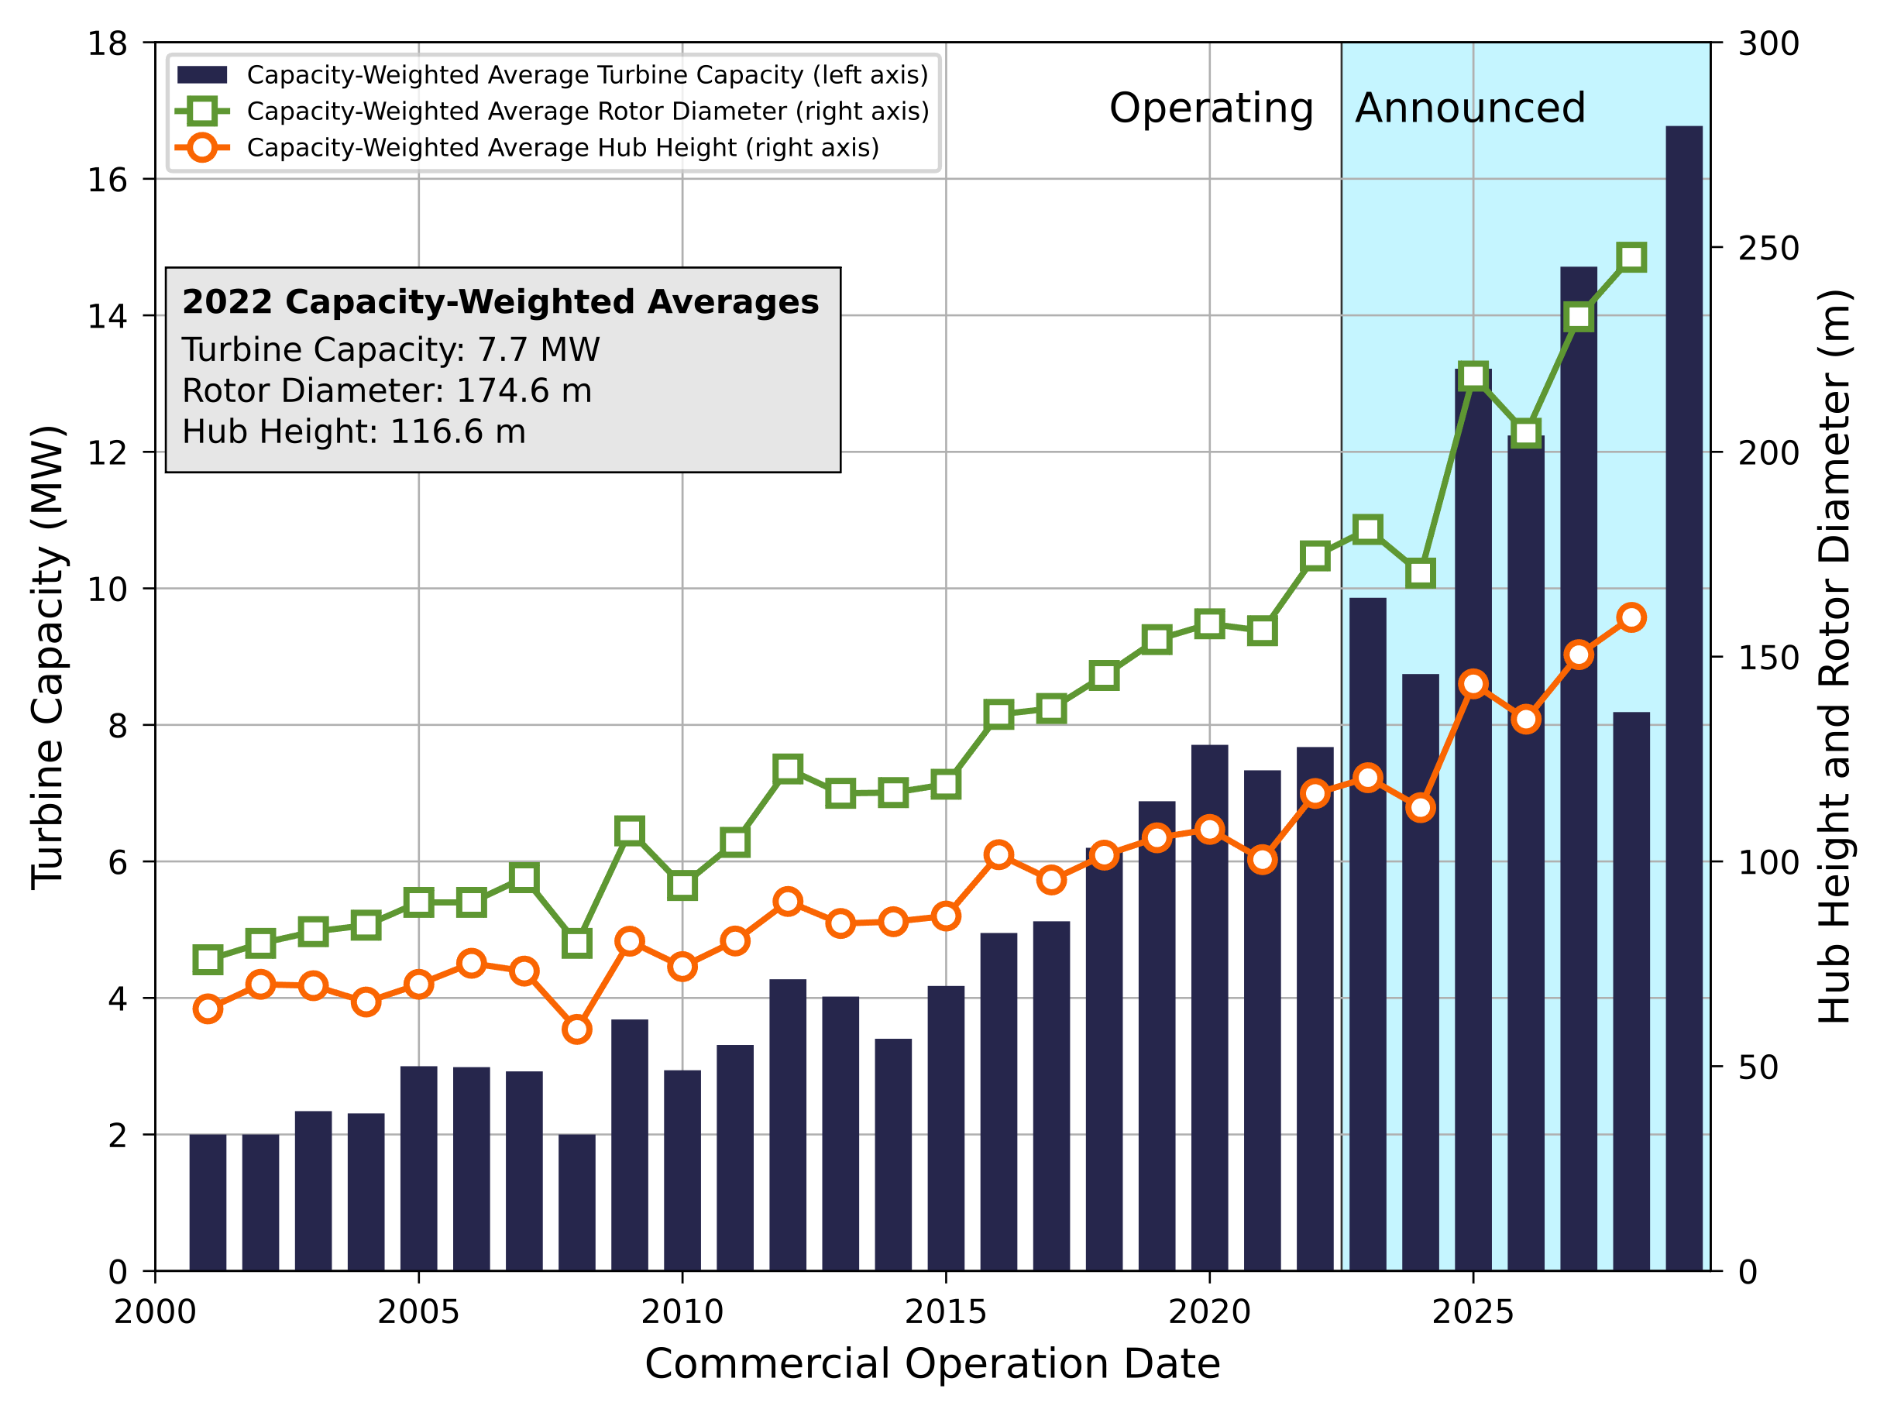
2022 Market Average Offshore Wind Turbine and Representative Wind Plant
Parameter | Value
Wind turbine rating | 12.0 MW
Rotor diameter | 216 m
Hub height | 137 m
Specific power | 327 W/m²
Wind plant capacity | 600 MW
Number of turbines | 50
Representative turbine parameters and power curves available on GitHub
Global capacity-weighted average turbine rating in 2022 was 7.7 MW, up from 7.4 MW in 2021 (Musial et al. 2023).
The first commercial-scale offshore wind projects installed in the United States selected 11-MW (South Fork Wind) and 13-MW (Vineyard Wind I) turbines.
Global capacity-weighted average turbine rating, hub height, and rotor diameter for offshore wind projects in 2022.
Source: Offshore Wind Market Report: 2023 Edition (Musial et al. 2023)

Slide 36
Offshore Wind Reference Wind Sites and Wind Plant Performance
The fixed-bottom offshore wind reference project represents near-term development in the U.S. Northeast.
The floating offshore wind reference site represents the first leases in California.
Parameter | Fixed-Bottom | Floating | Units
Water depth | 34 | 739 | m
Export cable length | 50 | 36 | km
Annual average wind speed at 50 m | 8.43 | 7.67 | m/s
Annual average wind speed at hub height | 9.05 | 8.24 | m/s
Weibull k | 2.1 | 2.1 | factor
Shear exponent | 0.1 | 0.1 | #
Gross energy capture | 5,081 | 4,205 | MWh/MW/yr
Gross capacity factor | 58.0 | 48.0 | %
Total losses | 15.5 | 20.7 | %
Net energy capture | 4,295 | 3,346 | MWh/MW/yr
Net capacity factor | 49.0 | 38.2 | %
Wind resource of the United States, annual average wind speed at 100 meters above surface level. Source: NREL (2017)

Slide 37
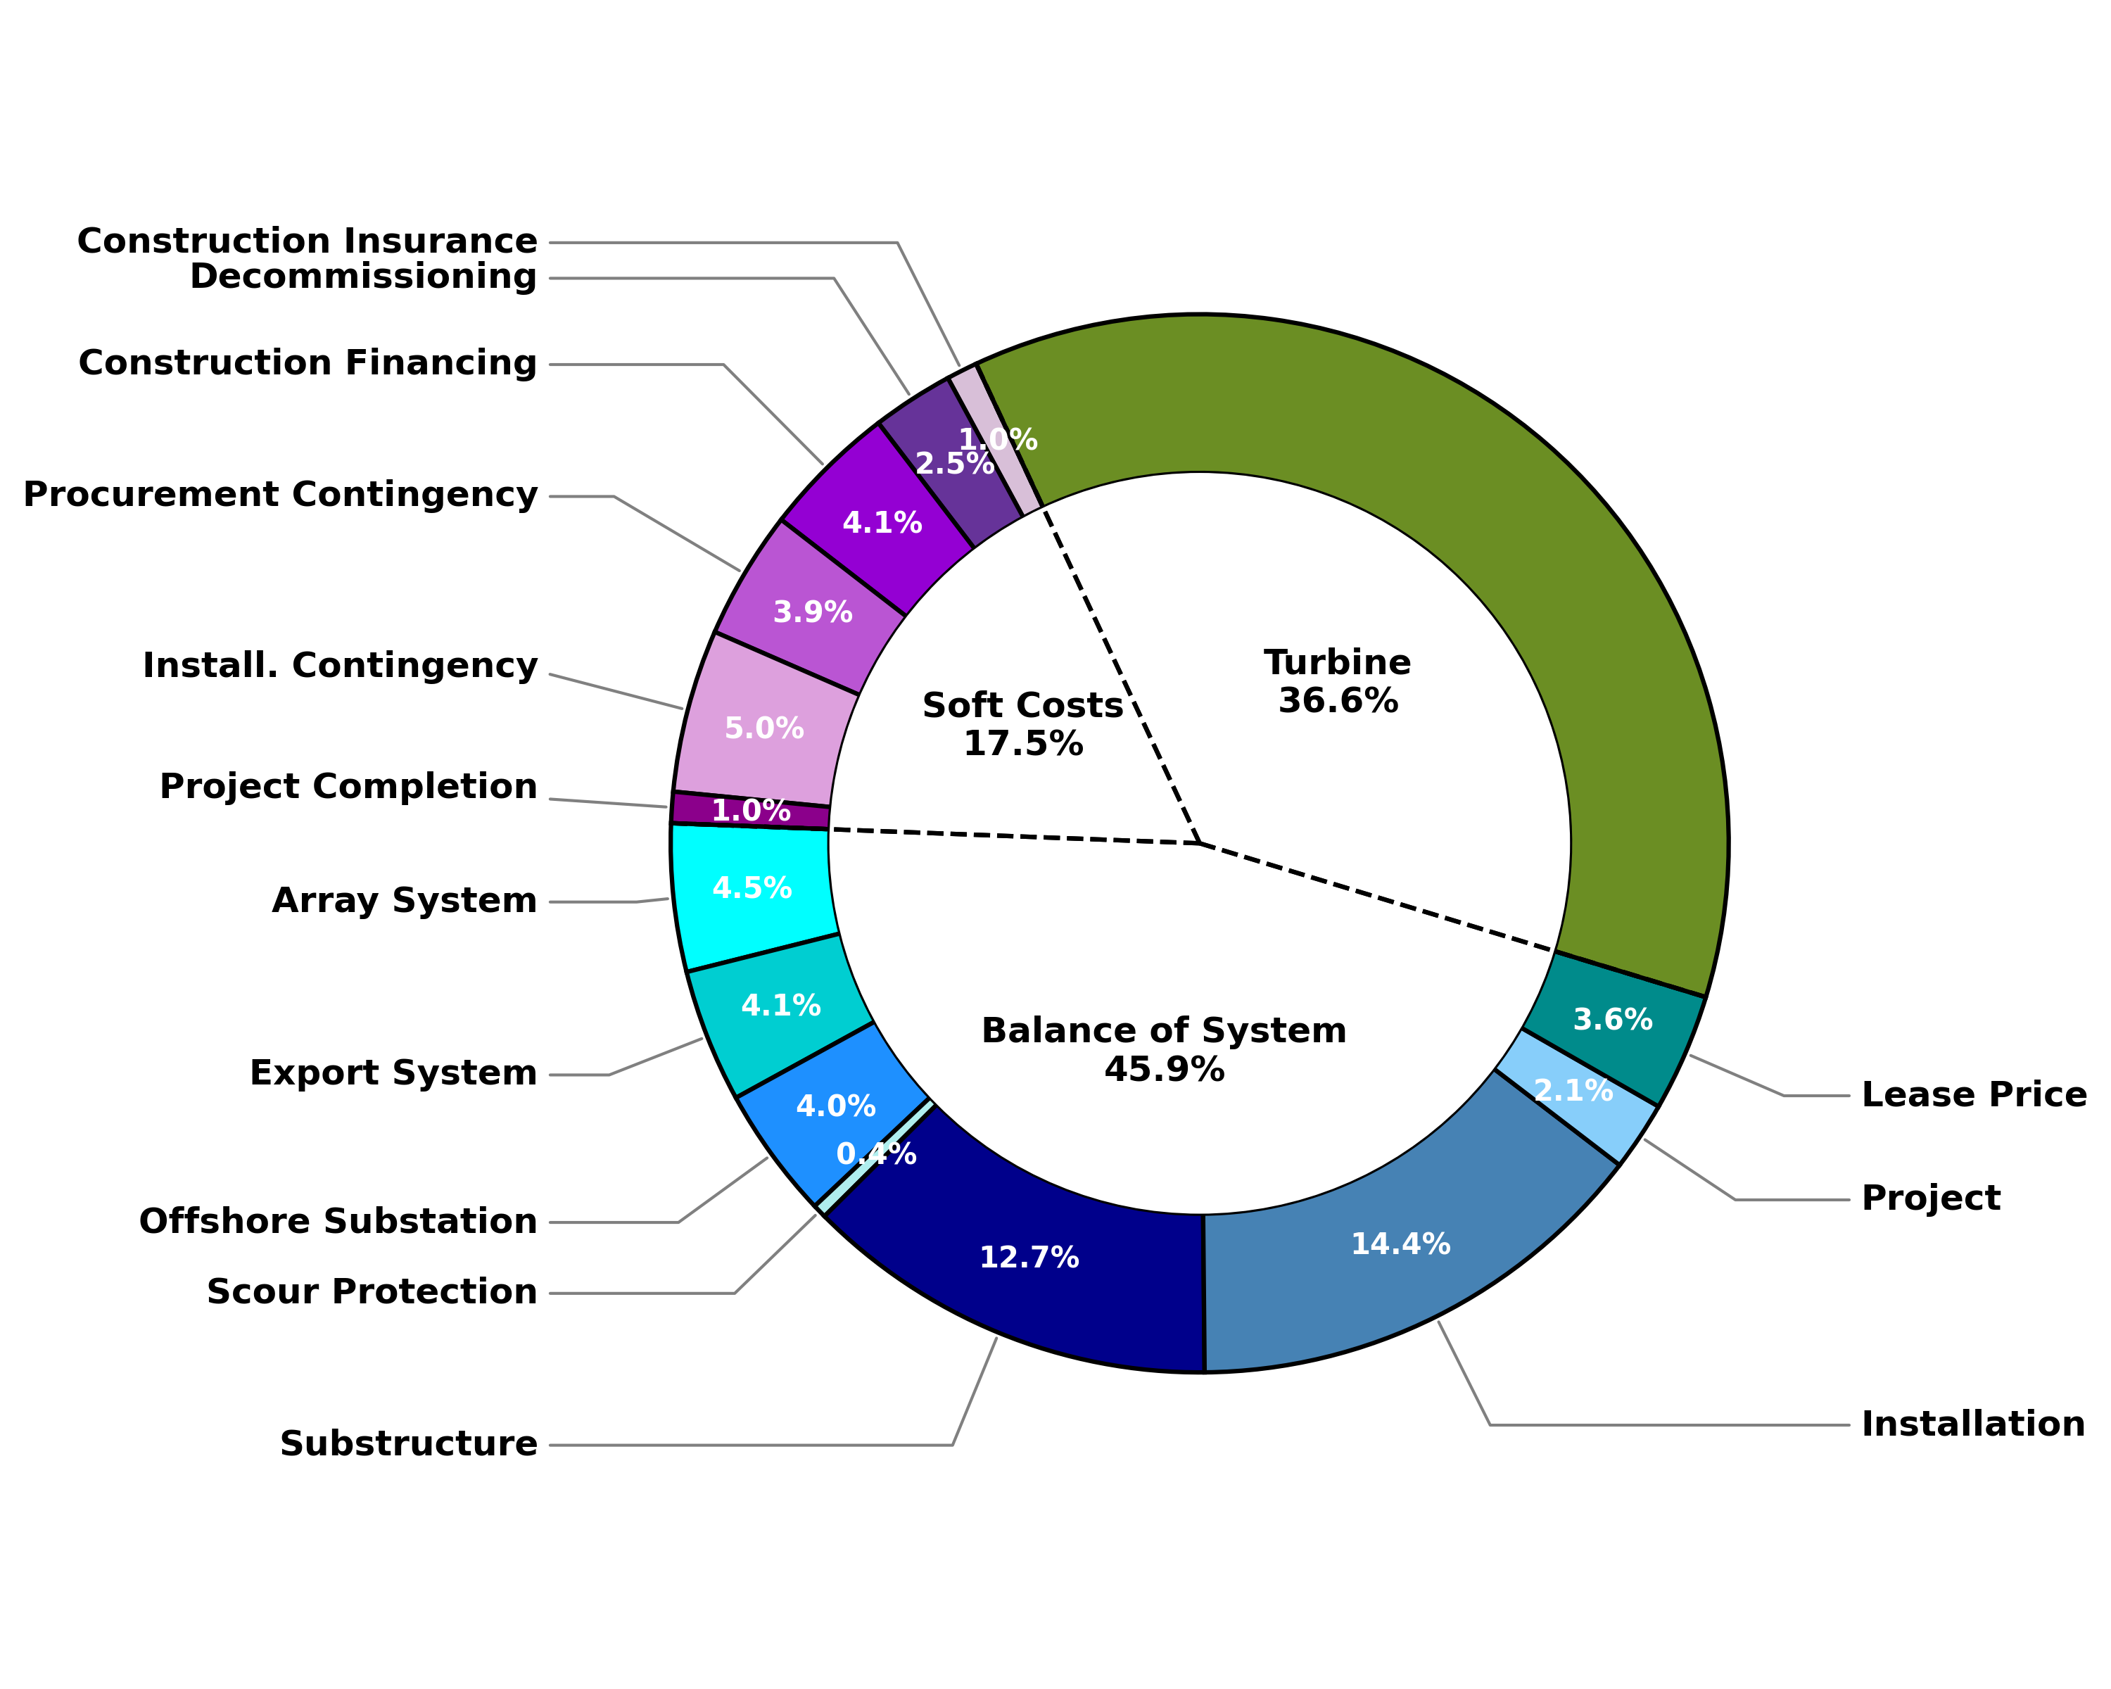
Fixed-Bottom Offshore Wind System CapEx Component Cost Breakdown
Parameter | Value ($2022/kW)
Total Turbine | 1,700
Turbine | 1,700
Total Balance of System | 2,130
Array System | 210
Export System | 189
Offshore Substation | 187
Scour Protection | 20
Substructure | 589
Installation | 670
Project | 98
Lease Price | 167
Total Soft Costs | 810
Construction Insurance | 44
Decommissioning | 116
Construction Financing | 192
Procurement Contingency | 182
Install. Contingency | 231
Project Completion | 44
Total CapEx | 4,640
Parameter | Value ($/kW)
Turbine | 1,700
BOS | 2,130
Development and project management | 98
Substructure and foundation | 609
Electrical infrastructure | 1027
Assembly and installation | 229
Lease price | 167
Soft Costs | 809
Plant commissioning | 44
Decommissioning | 116
Contingency | 414
Construction finance | 192
Insurance during construction | 44
Total CapEx | 4,640
Values rounded to the nearest dollar

Slide 38
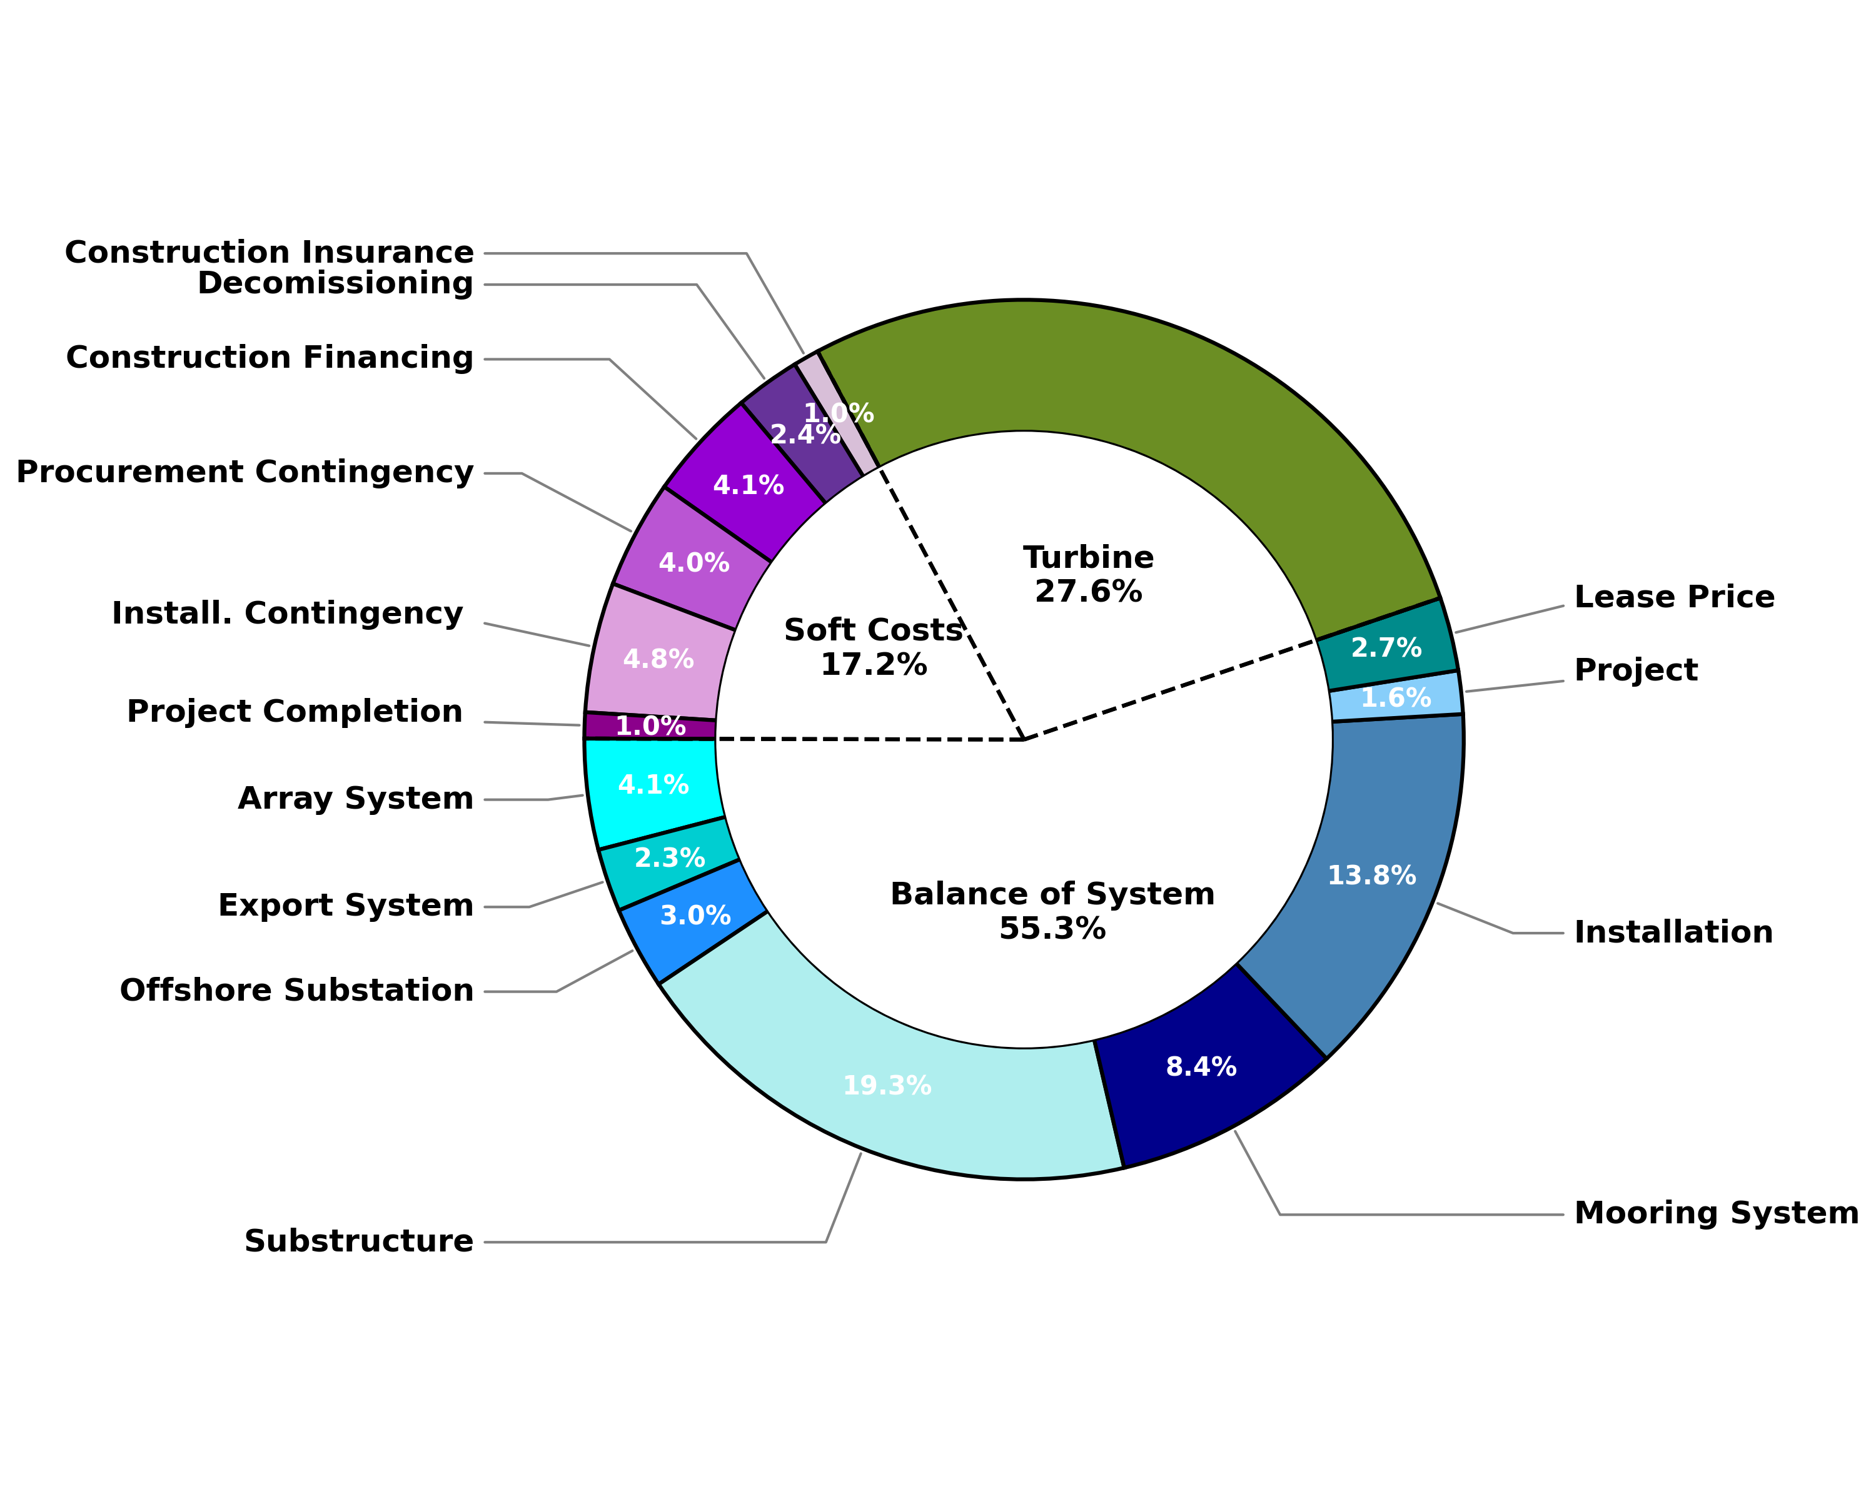
Floating Offshore Wind System CapEx Component Cost Breakdown
Parameter | Value ($2022/kW)
Total Turbine | 1,700
Turbine | 1,700
Total Balance of System | 3,409
Array System | 251
Export System | 143
Offshore Substation | 187
Substructure | 1,189
Mooring System | 519
Installation | 854
Project | 98
Lease Price | 167
Total Soft Costs | 1,060
Construction Insurance | 59
Decomissioning | 147
Construction Financing | 255
Procurement Contingency | 245
Install. Contingency | 295
Project Completion | 59
Total CapEx | 6,169
Parameter | Value ($/kW)
Turbine | 1,700
BOS | 3,409
Development and project management | 98
Substructure and foundation | 1,708
Electrical infrastructure | 1,157
Assembly and installation | 279
Lease price | 167
Soft Costs | 1,060
Plant commissioning | 59
Decommissioning | 147
Contingency | 540
Construction finance | 255
Insurance during construction | 59
Total CapEx | 6,169

Slide 39
Fixed-Bottom and Floating Offshore Wind OpEx Estimates
Parameter | Fixed Value ($/kW-yr) | Floating Value ($/kW-yr)
Maintenance | 91.0 | 56.0
Labor (technicians) | 4.0 | 4.0
Materials | 2.0 | 3.0
Equipment (vessels) | 85.0 | 49.0
Operations | 18.0 | 31.0
Management administration | 2.0 | 2.0
Port fees | 1.0 | 14.0
Insurance | 15.0 | 15.0
Total OpEx | 109.0 | 87.0
Fixed-bottom and floating offshore wind plant OpEx estimates are calculated with NREL’s Windfarm Operations & Maintenance cost-Benefit Analysis Tool (WOMBAT) (Hammond and Cooperman 2022).
WOMBAT is a scenario-based tool that uses a discrete event simulation framework to calculate the costs associated with component failures, scheduled maintenance tasks, and mobilization of equipment to carry out repairs.
OpEx modeling assumptions:
30 full-time technicians assumed per project in both sites.
Three crew transfer vessels, one cable lay vessel, and one diving support vessel per project.
Fixed-bottom site employs a jack-up vessel for replacements.
Floating case executes replacements through a tow-to-port strategy.
Failure rates and costs associated with repairs and replacements informed by COREWIND (2021).
Parameter | Fixed Value ($/kW-yr) | Floating Value ($/kW-yr)
Maintenance | 91 | 56
Labor (technicians) | 4 | 4
Materials | 2 | 3
Equipment (vessels) | 85 | 49
Operations | 17 | 30
Management administration | 2 | 2
Port fees | 1 | 14
Insurance | 15 | 15
Total OpEx | 108 | 87
Values rounded to the nearest dollar
Access the WOMBAT model on GitHub.

Slide 40
Fixed-Bottom and Floating Offshore Wind Project Financial Assumptions
Parameter | Nominal Value | Real Value
Weighted average cost of capital | 6.23% | 3.64%
Capital recovery factor | 7.99% | 6.20%
Fixed charge rate | 8.42% | 6.48%
The data used to calculate the weighted average cost of capital (WACC) are collected by NREL based on conversations with project developers and industry financiers and provides a basis for WACC assumptions for the representative wind project in 2022.
The WACC, CRF, and FCR are given in nominal and real terms using the after-tax WACC discount rate of 6.23% and 3.64%, respectively, a project design lifetime of 25 years, and a net present value depreciation factor of 86.9% (assuming a 5-year MACRS depreciation schedule).
Detailed financial assumptions are displayed in the Appendix.
Note: The WACC for land-based wind is higher than for offshore wind because it considers the influences of the production tax credit and assumes a lower debt fraction.

Slide 41
2022 Offshore Wind Reference Plant LCOE Estimates
Unnamed: 0 | Unnamed: 1 | Offshore | Offshore.1
Parameter | Units | Utility Scale (Fixed-Bottom) | Utility Scale (Floating)
Wind turbine rating | MW | 12.0 | 12.0
Capital expenditures (CapEx) | $/kW | 4,640 | 6,169
Fixed charge rate (FCR) (real) | % | 6.48 | 6.48
Operational expenditures (OpEx) | $/kW/yr | 109 | 87
Net annual energy production | MWh/MW/yr | 4,295 | 3,346
Levelized cost of energy (LCOE) | $/MWh | 95 | 145
The LCOE values for the 2022 representative fixed-bottom and floating offshore wind plants are estimated at $95/MWh and $145/MWh, respectively.
Calculated with the formulation presented in NREL’s Annual Technology Baseline and presented in Appendix.
Parameter | Fixed-Bottom 12.0-MW Offshore Wind Turbine | Floating 12.0-MW Offshore Wind Turbine | Units
Capital expenditures | 4,640 | 6,169 | $/kW
Fixed charge rate (real) | 6.48 | 6.48 | %
Operational expenditures | 108 | 87 | $/kW/yr
Net annual energy production | 4,295 | 3,346 | MWh/MW/yr
Total LCOE | 95 | 145 | $/MWh

Slide 42
Levelized Cost Breakdown for Reference Fixed-Bottom Offshore Wind Plant
Turbine (27.0%)
Balance of System CapEx (31.9%)
OpEx (26.4%)
Financial CapEx (14.8%)
* Engineering Management cost small, but nonzero

Slide 43
Levelized Cost Breakdown for Reference Floating Offshore Wind Plant
Turbine (22.7%)
OpEx (17.8%)
Financial CapEx (14.1%)
Balance of System CapEx (45.4%)
* Engineering Management cost small, but nonzero

Slide 44
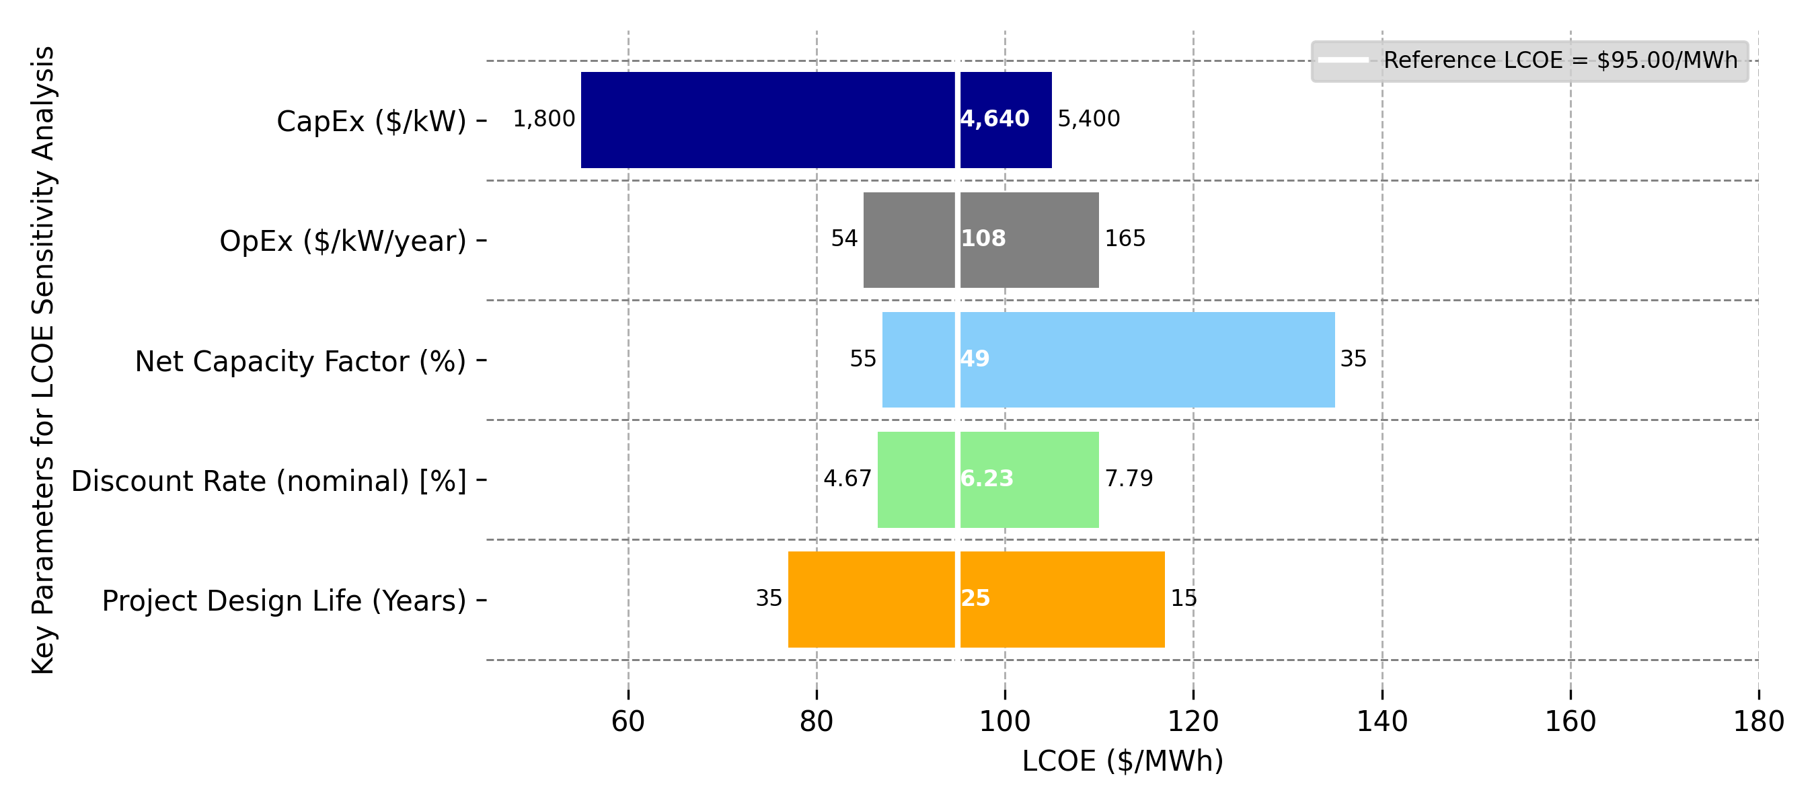
Range of LCOE Parameters for Fixed-Bottom Offshore Wind Platform
Note: The reference LCOE reflects a representative industry LCOE. Changes in LCOE for a single variable can be understood by moving to the left or right along a specific variable. Values on the x-axis indicate how the LCOE will change as a given variable is altered and all others are assumed constant (i.e., remain reflective of the reference project).

Slide 45
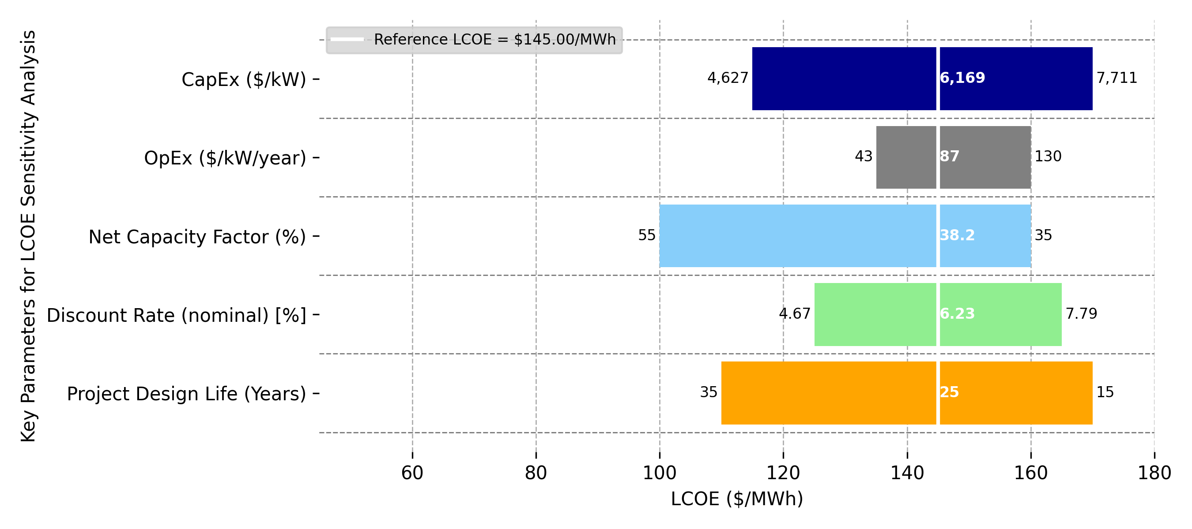
Range of LCOE Parameters for Floating Offshore Wind Platform
Note: The reference LCOE reflects a representative industry LCOE. Changes in LCOE for a single variable can be understood by moving to the left or right along a specific variable. Values on the x-axis indicate how the LCOE will change as a given variable is altered and all others are assumed constant (i.e., remain reflective of the reference project).

Slide 46
5. Distributed Wind Energy

Slide 47
Distributed Wind Turbine Characteristics for Residential, Commercial, and Large-Scale Projects
Parameter | Wind Turbine Class |  |  | Units
 | Residential | Commercial | Large
Wind turbine rating | 20 | 100 | 1,500 | kW
Rotor diameter | 12.4 | 27.6 | 77 | m
Hub height | 30 | 40 | 80 | m
Specific power | 166 | 167 | 322 | W/m²
Number of wind turbines | 1 | 1 | 1 | #
Wind turbine classes are aligned with the Distributed Wind Energy Futures Study (McCabe et al. 2022).

Slide 48
Distributed Wind Site Characteristics and Performance
Parameter | Wind Turbine Class |  |  | Units
 | Residential | Commercial | Large
Annual average wind speed at 50 m above surface level | 6 | 6 | 6 | m/s
Annual average wind speed at hub height | 5.58 | 5.81 | 6.42 | m/s
Weibull k | 2.0 | 2.0 | 2.0 | factor
Shear exponent | 0.14 | 0.14 | 0.14 | #
Gross energy capture | 2,916 | 3,217 | 3,759 | MWh/MW/yr
Gross capacity factor | 33.3 | 36.7 | 42.9 | %
Losses | 6.9 | 6.9 | 6.9 | %
Availability | 95 | 95 | 95 | %
Total losses | 11.5 | 11.5 | 11.5 | %
Net energy capture | 2,580 | 2,846 | 3,326 | MWh/MW/yr
Net capacity factor | 29.5 | 32.5 | 38 | %
Residential and commercial wind turbines assume stall-regulated power curves; the large wind turbine assumes pitch-regulated power curve.
Power curve data available on https://github.com/NREL/turbine-models.

Slide 49
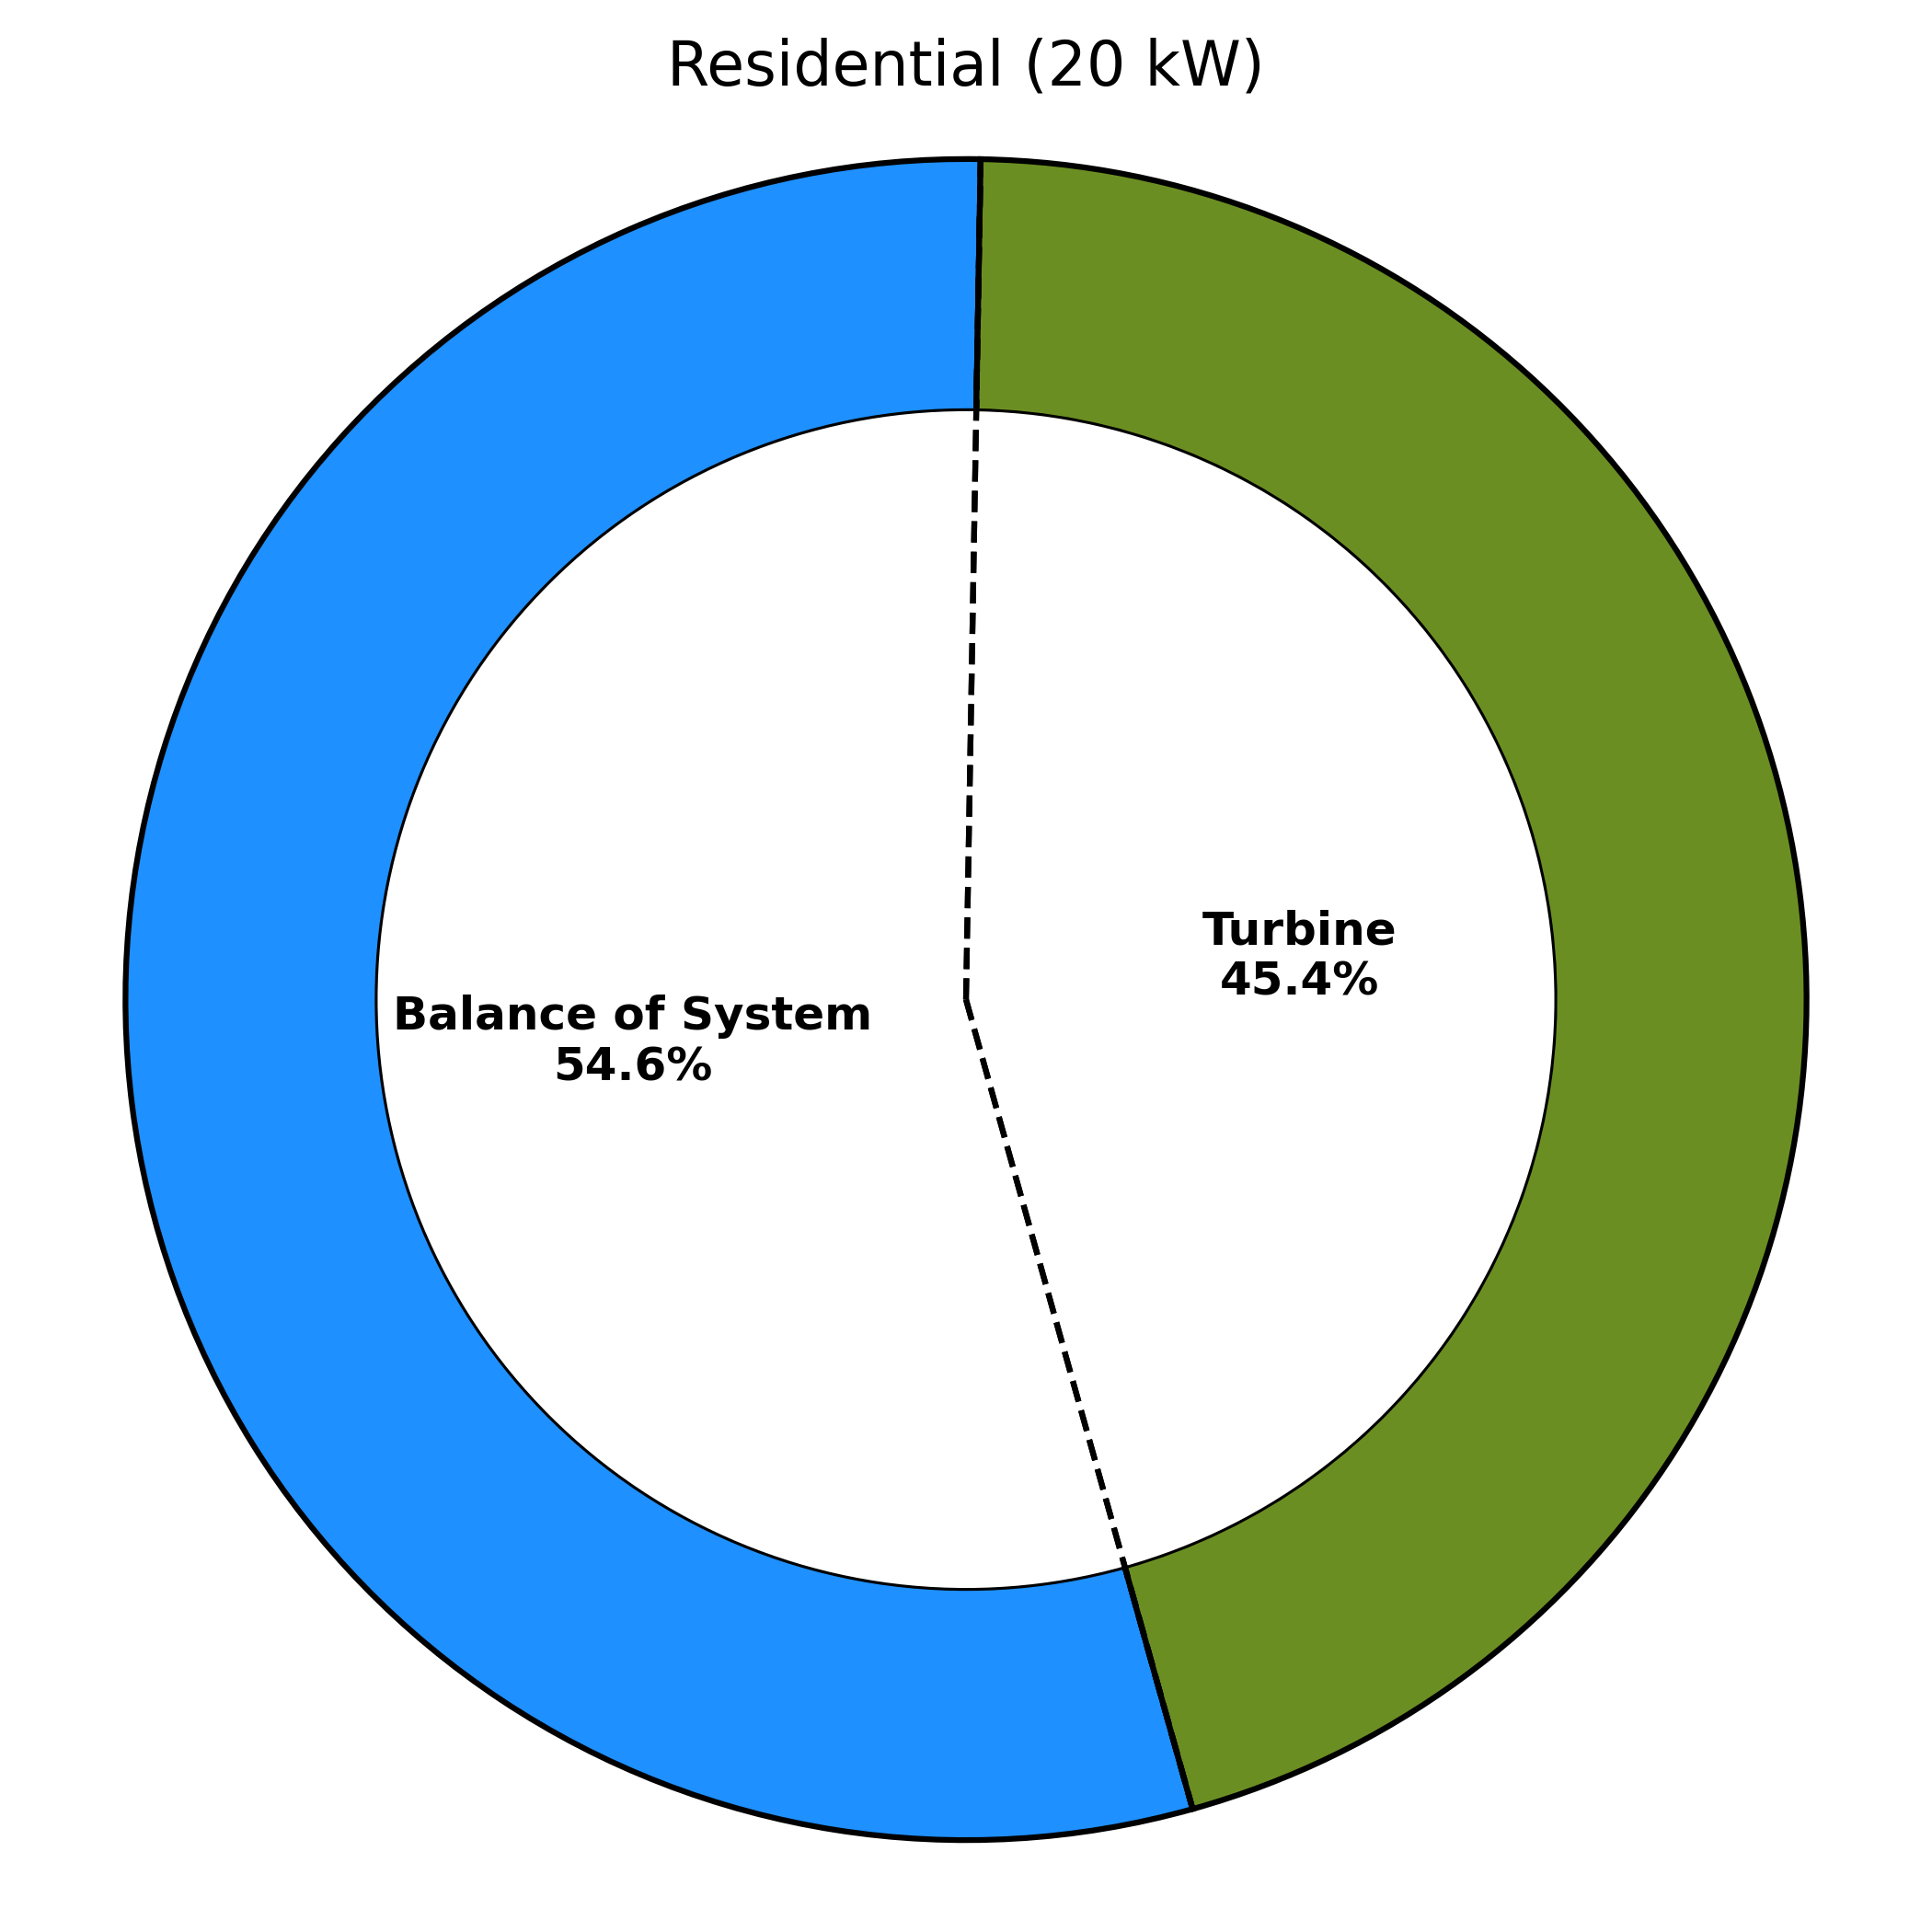
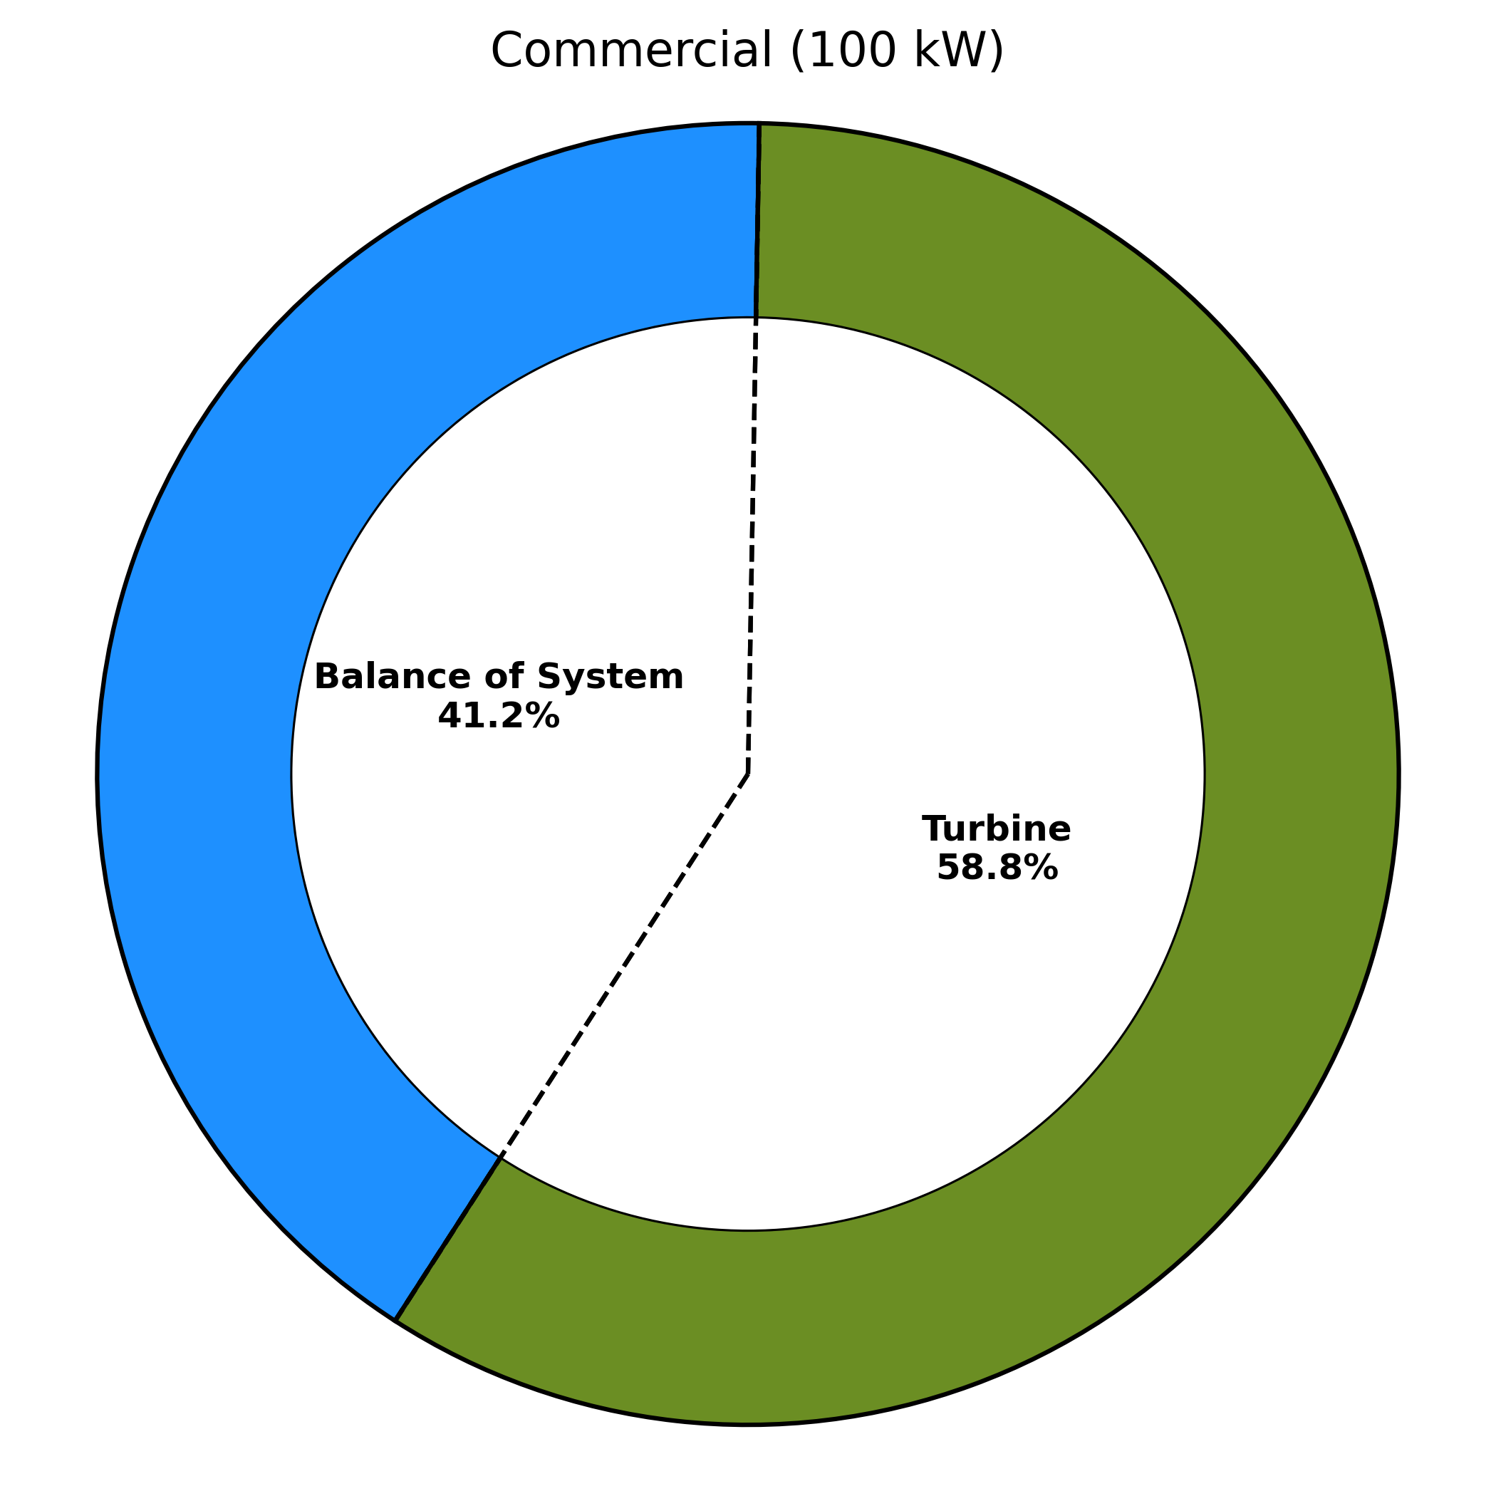
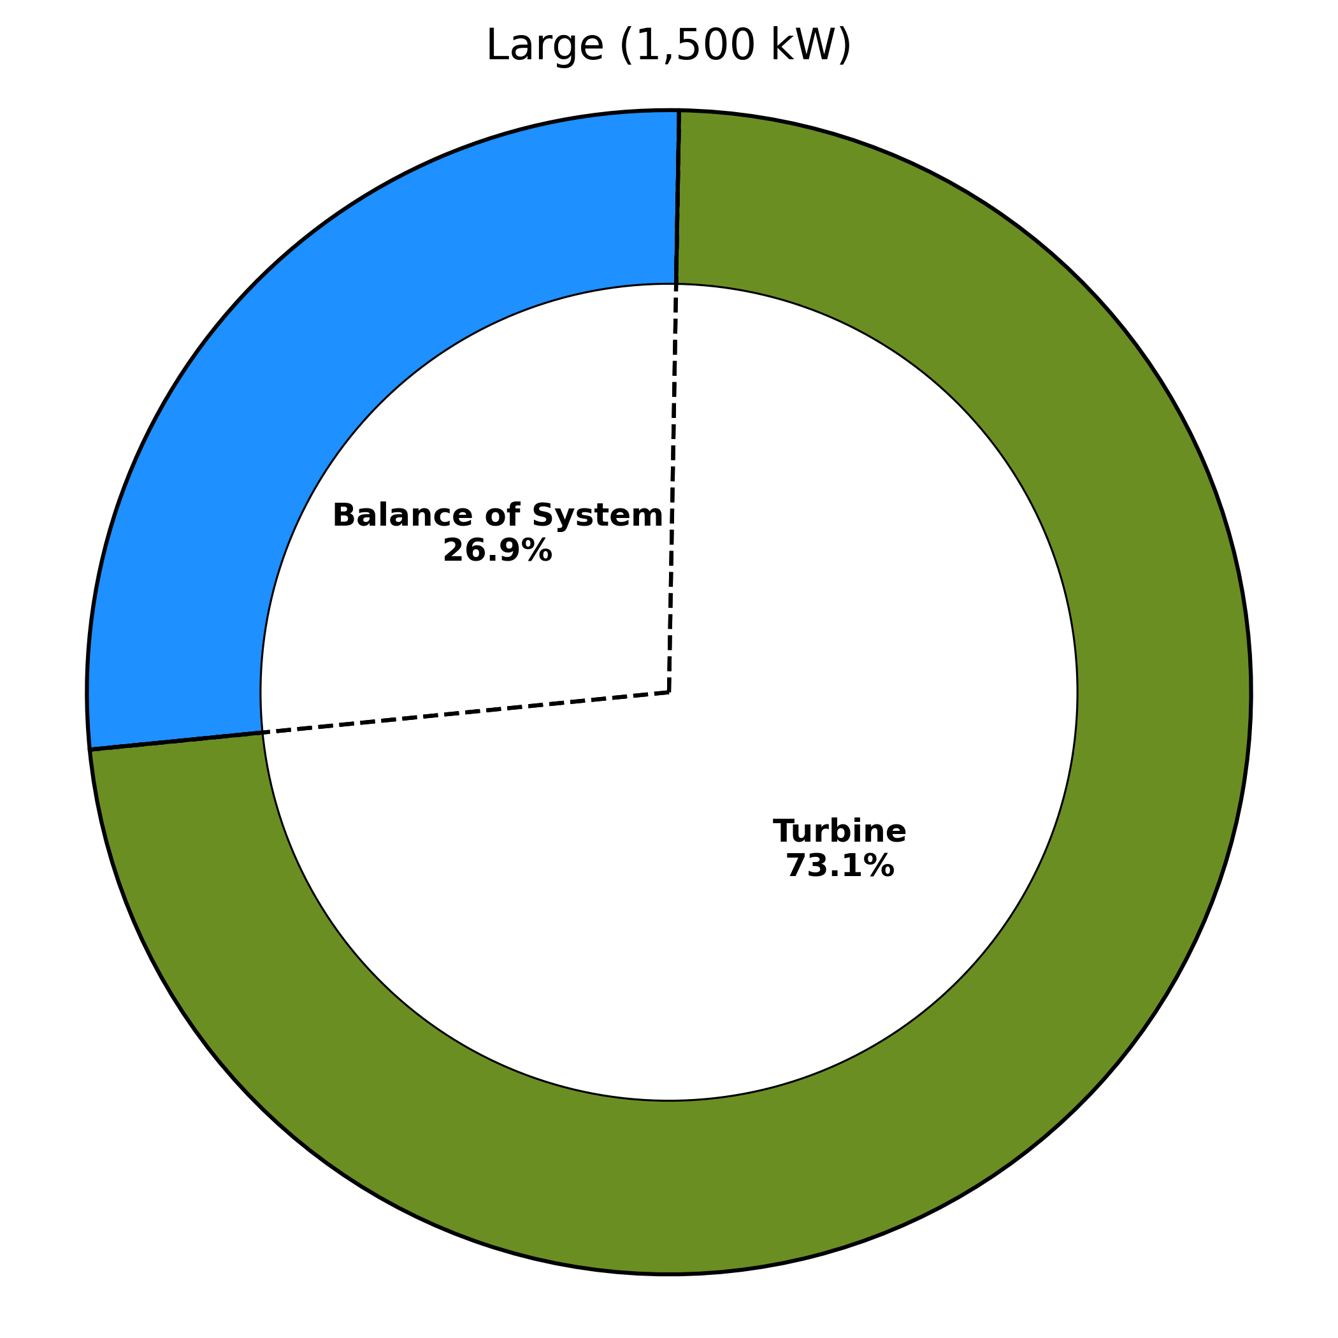
Distributed Wind Project Component Cost Breakdown and Estimated Operational Expenditures
Residential (20 kW)
Commercial (100 kW)
Large (1,500 kW)
Parameter | Residential | Commercial | Large | Units
Wind Turbine CapEx | 3,823 | 3,723 | 2,392 | $2022/kW
BOS CapEx | 4,602 | 2,604 | 878 | $2022/kW
Total CapEx | 8,425 | 6,327 | 3,270 | $2022/kW
OpEx | 39 | 39 | 39 | $2022/kW/yr
Parameter | Wind Turbine Class |  |  | Units
 | Residential | Commercial | Large
Wind turbine CapEx | 3,823 | 3,723 | 2,392 | $/kW
BOS CapEx | 4,602 | 2,604 | 878 | $/kW
Total CapEx | 8,425 | 6,327 | 3,270 | $/kW
OpEx | 39 | 39 | 39 | $/kW/yr
BOS component cost estimates are obtained from the LandBOSSE model (Eberle et al. 2019).
Because CapEx data are scarce for distributed wind projects, further cost details on the individual system components are not presented.
OpEx market data are not widely available for distributed wind projects; therefore, $39/kW/yr is assumed for each wind class and is aligned with the 2023 ATB atb.nrel.gov.

Slide 50
Distributed Wind Project Financial Assumptions
Parameter | Nominal | Real
Weighted average cost of capital (%) | 6.57 | 3.97
Capital recovery factor (%) | 8.25 | 6.38
Fixed charge rate (%) | 8.7 | 6.73
The economic evaluation of wind energy investments in this analysis uses the fixed charge rate (FCR) method used in NREL’s Annual Technology Baseline and Standard Scenarios web page: atb.nrel.gov.
The FCR represents the amount of annual revenue required to pay the carrying charge as applied to the CapEx on that investment during the expected project economic life and is based on the CRF but also reflects corporate income taxes and depreciation.
The analysis assumes the reference projects operate for 25 years and a 5-year MACRS depreciation schedule; for simplicity, financial assumptions are assumed to be the same for each wind class and are aligned with the assumptions in the 2023 Annual Technology Baseline atb.nrel.gov.
Additional financial assumption details are displayed in the Appendix.

Slide 51
LCOE Breakdown for Reference Distributed Wind Projects
Single-Turbine Residential
(20 kW)
Single-Turbine Commercial
(100 kW)
Single-Turbine Large
(1,500 kW)

Slide 52
6. References

Slide 53
References
Beiter, P., W. Musial, A. Smith, L. Kilcher, R. Damiani, M. Maness, et al. 2016. A Spatial-Economic Cost Reduction Pathway Analysis for U.S. Offshore Wind Energy Development from 2015-2030. Golden, CO: National Renewable Energy Laboratory. NREL/TP6A20-66579. https://www.nrel.gov/docs/fy16osti/66579.pdf.
Bureau of Labor and Statistics. Undated. “CPI Inflation Calculator.” Accessed September 2022. https://www.bls.gov/data/#calculators.
COREWIND. 2021. Floating Wind O&M Strategies Assessment. COREWIND. August 2021. https://corewind.eu/wp-content/uploads/files/publications/COREWIND-D4.2-Floating-Wind-O-and-M-Strategies-Assessment.pdf.
Eberle, A., O. Roberts, A. Key, P. Bhaskar, and K. Dykes. 2019. NREL’s Balance-of-System Cost Model for Land-Based Wind. Golden, CO: National Renewable Energy Laboratory. NREL/TP-6A20-72201. https://www.nrel.gov/docs/fy19osti/72201.pdf.
Hammond, R. and A. Cooperman. 2022. Windfarm Operations and Maintenance cost-Benefit Analysis Tool (WOMBAT). Golden, CO: National Renewable Energy Laboratory. NREL/TP-5000-83712. https://www.nrel.gov/docs/fy23osti/83712.pdf.
McCabe, K., A. Prasanna, J. Lockshin, P. Bhaskar, T. Bowen, R. Baranowski, B. Sigrin, and E. Lantz. 2022. Distributed Wind Energy Futures Study. Golden, CO: National Renewable Energy Laboratory. NREL/TP-7A40-82519. https://www.nrel.gov/docs/fy22osti/82519.pdf.
Musial, W., P. Spitsen, P. Duffy, P. Beiter, M. Shields, D. Mulas Hernando, R. Hammond, M. Marquis, J. King, and S. Sathish. 2023. Offshore Wind Market Report: 2023 Edition. Washington, D.C.: U.S. Department of Energy. DOE/GO-102023-6059. https://cms.doe.gov/sites/default/files/2023-08/offshore-wind-market-report-2023-edition_0.pdf.
National Renewable Energy Laboratory (NREL). 2017. “Wind Resource Maps and Data.” https://www.nrel.gov/gis/wind-resource-maps.html.
National Renewable Energy Laboratory (NREL). Undated. “Annual Technology Baseline.” Accessed September 2022. https://atb.nrel.gov/.

Slide 54
References
Short, W., D. J. Packey, and T. Holt. 1995. A Manual for the Economic Evaluation of Energy Efficiency and Renewable Energy Technologies. Golden, CO: National Renewable Energy Laboratory. NREL/TP-462-5176. http://www.nrel.gov/docs/legosti/old/5173.pdf.
Shields, M., P. Beiter, and J. Nunemaker. 2022. A Systematic Framework for Projecting the Future Cost of Offshore Wind Energy. Golden, CO: National Renewable Energy Laboratory. NREL/TP-5000-81819. https://www.nrel.gov/docs/fy23osti/81819.pdf.
Stehly, T. and P. Duffy. 2022. 2020 Cost of Wind Energy Review. Golden, CO: National Renewable Energy Laboratory. NREL/TP-5000-81209. https://www.nrel.gov/docs/fy22osti/81209.pdf.
Stehly, T., P. Beiter, P. Duffy. 2020. 2019 Cost of Wind Energy Review. Golden, CO: National Renewable Energy Laboratory. NREL/TP-5000-78471. https://www.nrel.gov/docs/fy21osti/78471.pdf.
UL Solutions. Undated. “Wind Farm Design Software Developed on More Than 30 Years of Expertise.” https://aws-dewi.ul.com/software/openwind/.
U.S. Department of the Treasury. 2023a. “Domestic Content Bonus Credit Guidance under Sections 45, 45Y, 48, and 48E.” Accessed December 2023. https://www.irs.gov/pub/irs-drop/n-23-38.pdf.
U.S. Department of the Treasury. 2023b. “Treasury Department Releases Guidance to Boost American Clean Energy Manufacturing.” Accessed December 2023. https://home.treasury.gov/news/press-releases/jy1477.
Valpy, B. G. Hundleby, K. Freeman, A. Roberts, A. Logan. 2017. Future renewable energy costs: Offshore wind; 57 technology innovations that will have greater impact on reducing the cost of electricity from European offshore wind farms. InnoEnergy and BVG Associates. https://bvgassociates.com/wp-content/uploads/2017/11/InnoEnergy-Offshore-Wind-anticipated-innovations-impact-2017_A4.pdf.
Wiser, R. and M. Bolinger. 2023. Land-Based Wind Market Report: 2023 Edition. Washington, D.C.: U.S. Department of Energy DOE/GO-102023-6055. https://www.energy.gov/eere/wind/articles/land-based-wind-market-report-2023-edition.

Slide 55
References
Wiser, R., J. Rand, J. Seel, P. Beiter, E. Baker, E. Lantz, and P. Gilman. 2021. “Expert Elicitation Survey Predicts 37% to 49% Declines in Wind Energy Costs by 2050.” Nature Energy 6: 555–565. https://doi.org/10.1038/s41560-021-00810-z.

Slide 56
7. Appendix

Slide 57
FY 2023 GPRA Values Reported in Original Baseline Plant Terms
WETO is required to report annual GPRA results in the same terms as they were established.
The table reports the FY 2023 GPRA values in the same terms as when the GPRA targets were established (i.e., land-based wind 2015 USD and offshore wind 2018 USD).
All WETO FY 2023 GPRA targets were met.
In FY 2024 WETO will report against the new GPRA targets as established in this report.
 |  | Land-Based Wind |  | Fixed-Bottom Offshore Wind
Parameter | Unit | FY22 Value | FY23 Value | FY22 Value | FY23 Value
Annual average wind speed (50 m above the ground) | m/s | 7.25 | 7.25 | 8.43 | 8.43
Wind turbine rating | MW | 3 | 3.3 | 8 | 12
Rotor diameter | m | 127 | 148 | 159 | 216
Hub height | m | 95 | 100 | 102 | 137
CapEx | $/kW | 1,501 | 1,750 | 3,871 | 3,965
OpEx | $/kW-yr | 40 | 41 | 111 | 90
Net capacity factor | (%) | 43.1 | 46.8 | 49 | 49
Real fixed charge rate | (%) | 5.88 | 5.88 | 5.82 | 5.82
LCOE | 2015$/MWh | 29 | 28 | 70 | 63
LCOE | 2018$/MWh | N/A | N/A | 70 | 63
 | 2022$/MWh | 36 | 35 | 83 | 75
FY23 GPRA LCOE target (inflation adjusted) | cents/kWh | 2.9 | 2.8 | 7 | 6.9
FY23 GPRA status | N/A | Met | Met | Met | Met

Slide 58
Methodology for Estimating Manufactured Product Component Breakdown for Land-Based Wind Facilities
The categorization of applicable project components for a land-based wind facility are specified in the Internal Revenue Service Notice 2023-38, section 3.04 and are subject to steel/iron or manufactured product requirement.
Manufactured product costs and cost contributions were calculated for a range of wind turbine sizes.
Wind turbine component masses from planned or offered wind turbines in the United States in the range of 2–6 MW were used to develop scaling relationships.
The Cost and Scaling Model (https://github.com/WISDEM/WISDEM) was then used to estimate component masses and costs.
Average component price values and relative manufactured product contributions were reviewed by industry members, including representatives from turbine original equipment manufacturers and blade manufacturers.
Table 2 - Categorization of Applicable Project Components
Applicable Project | Applicable Project Component | Categorization
Land-based wind facility | Tower | Steel/Iron
 | Steel or iron rebar in foundation | Steel/Iron
 | Nacelle | Manufactured Product
 | Blades | Manufactured Product
 | Rotor hub | Manufactured Product
 | Power Converter | Manufactured Product
 | Wind tower flanges | Manufactured Product
Table source: U.S. Department of the Treasury (2023a)

Slide 59
Land-Based Wind Reference Project Details
Parameter | Units | Value | Notes
Wind Plant and Reference Site Characteristics
Wind plant capacity | MW | 200 | Representative of current commercial-scale projects atb.nrel.gov
Number of turbines |  | 61
Turbine rating | MW | 3.3
Rotor diameter | m | 148
Hub height | m | 100
Specific power | W/m2 | 192 | Calculation
Annual average wind speed at 50 meters | m/s | 7.25 | Reference site wind speed
Annual average wind speed at hub height | m/s | 8.01 | Between International Electrotechnical Class (IEC) class III (7.5 m/s) and IEC class II (8.5 m/s)
Weibull k factor |  | 2.0
Shear exponent |  | 0.143 | Shear for neutral stability conditions
Total system losses | % | 18.9% | atb.nrel.gov
Net energy capture | MWh/MW/yr | 4,100 | System Advisor Model (SAM) calculation
Net capacity factor | % | 46.8%

Slide 60
Land-Based Wind System CapEx Breakdown
Parameter | Value ($/kW) | Notes
CapEx
Total CapEx | 1,750 | Calculation
Turbine | 969 | Cost and Scaling Model (https://github.com/WISDEM/WISDEM)
Rotor module | 300
Blades | 251
Pitch assembly | 12
Hub assembly | 38
Nacelle module | 424
Nacelle structural assembly | 67
Drivetrain assembly | 210
Nacelle electrical assembly | 122
Yaw assembly | 25
Tower module | 245
(Continued on next slide)

Slide 61
Land-Based Wind System CapEx Breakdown (continued)
Parameter | Value | Notes
CapEx
Balance of system | 517 | Land-based Balance of System Systems Engineering [LandBOSSE] (Eberle et al. 2019)
Development | 32
Engineering and project management | 12
Foundation | 106
Site access and staging | 42
Assembly and installation | 89
Electrical infrastructure | 64
Wind turbine transport | 172
Soft costs | 264
Construction finance | 102 | atb.nrel.gov
Contingency | 48 | Includes insurance, permitting, bonding, and markup estimates
Wind turbine warranty | 115 | Assumes 2-year warranty

Slide 62
Land-Based Wind OpEx and Financing Terms
Parameter | Units | Value | Notes
OpEx
Total OpEx | $/kW/year | 41 | atb.nrel.gov
Financials
Project design life | Years | 25 | Project life assumption for Government Performance and Reporting Act (GPRA) reporting
Tax Rate (combined state and federal) | % | 25.7% | atb.nrel.gov
Inflation rate | % | 2.5%
Interest during construction (nominal) | % | 6.5%
Construction finance factor | % | 106.2% | Calculation
Debt fraction | % | 71.5% | atb.nrel.gov
Debt interest rate (nominal) | % | 7%
Return on equity (nominal) | % | 10%
WACC (nominal; after-tax) | % | 6.57% | Calculation
WACC (real; after-tax) | % | 3.97%
Capital recovery factor (nominal; after-tax) | % | 8.25%
Capital recovery factor (real; after-tax) | % | 6.38%
Depreciable basis | % | 100% | Simplified depreciation schedule
Depreciation schedule |  | 5-year MACRS | Modified Accelerated Cost Recovery System (MACRS) is standard for U.S. wind projects
Depreciation adjustment (net present value [NPV]) | % | 84.1% | Calculation
Project finance factor | % | 106%
FCR (nominal) | % | 8.70%
FCR (real) | % | 6.73%
Levelized cost of energy | $/MWh | 39 | Calculation

Slide 63
Fixed-Bottom Offshore Wind Reference Project Details
Assumption | Units | Value | Notes
Wind plant characteristics
Wind plant capacity | MW | 600 | Representative of commercial-scale projects
Number of turbines | Number | 50 | Calculation
Turbine rating | MW | 12 | Informed by Offshore Wind Market Report: 2023 Edition (Musial et al. 2023) and early U.S. fixed-bottom offshore wind projects
Rotor diameter | m | 216
Hub height | m | 137.0
Specific power | W/m2 | 327 | Calculation
Water depth | m | 34 | Representative fixed-bottom offshore site for COE Review
Substructure type |  | Monopile
Distance from shore | km | 50
Cut-in wind speed | m/s | 3
Cut-out wind speed | m/s | 25
Average annual wind speed at 50 m | m/s | 8.4
Average annual wind speed at hub height | m/s | 9.0
Shear exponent |  | 0.10
Weibull k |  | 2.1
Total system losses | % | 15.5% | Offshore Regional Cost Analyzer (ORCA) (based on Beiter et al. 2016)
Gross energy capture | MWh/MW/year | 5,081 | Calculation
Net energy capture | MWh/MW/year | 4,295
Gross capacity factor | % | 58.0% | Computed with FLORIS
Net capacity factor | % | 49.0%

Slide 64
Fixed-Bottom Offshore Wind System CapEx Breakdown
Assumption | Units | Value | Notes
CapEx
Total CapEx | $/kW | 4,640
Turbine | $/kW | 1,700 | Informed by Offshore Wind Market Report: 2023 Edition (Musial et al. 2023) and conversatons with industry partners
Rotor nacelle assembly | $/kW | 1,462
Tower | $/kW | 238
Balance of System | $/kW | 2,130 | BOS Costs computed with ORBIT (Nunemaker et al. 2020)
Development | $/kW | 96
Project management | $/kW | 2
Substructure and foundation | $/kW | 609
Substructure | $/kW | 226
Foundation | $/kW | 383
Port and staging, logistics, transportation | $/kW | 0
Electrical infrastructure | $/kW | 1,027
Array cable system | $/kW | 392
Export cable system | $/kW | 436
Grid connection | $/kW | 200
Assembly and installation | $/kW | 229
Turbine installation | $/kW | 90
Substructure and foundation installation | $/kW | 139
Soft Costs | $/kW | 810 | Soft Costs computed using same methodology as ORCA (Beiter et al. 2016)
Insurance during construction | $/kW | 44
Decommissioning bond | $/kW | 116
Construction finance | $/kW | 192
Sponsor contingency | $/kW | 414
Procurement contingency | $/kW | 182
Installation contingency | $/kW | 231
Project completions / commissioning | $/kW | 44

Slide 65
Fixed-Bottom Offshore Wind OpEx and Financing Terms
Assumption | Units | Value | Notes
OpEx
Total OpEx | $/kW/year | 108 | Calculated with WOMBAT
Operations (pretax) | $/kW/year | 17
Maintenance | $/kW/year | 91
Financials
Project design life | Years | 25 | Offshore wind project life for GPRA reporting
Tax Rate (combined state and federal) | % | 26% | Updated based on conversations with industry partners
Inflation rate | % | 2.5%
Debt fraction | % | 60%
Debt interest rate (nominal) | % | 5.9%
Return on equity (nominal) | % | 9.0%
WACC (nominal; after-tax) | % | 6.2% | Calculation
WACC (real; after-tax) | % | 3.6%
Capital recovery factor (nominal; after-tax) | % | 8.0%
Capital recovery factor (real; after-tax) | % | 6.2%
Depreciable basis | % | 100% | Simplified depreciation schedule
Depreciation schedule |  | 5 year MACRS | Standard for U.S. wind projects
Depreciation adjustment (NPV) | % | 84.8% | Calculation
Project finance factor | % | 105%
FCR (nominal) | % | 8.4%
FCR (real) | % | 6.5%
Levelized cost of energy | $/MWh | 95 | Calculation

Slide 66
Floating Offshore Wind Reference Project Details
Assumption | Units | Value | Notes
Wind plant characteristics
Wind plant capacity | MW | 600 | Representative of commercial-scale projects
Number of turbines | Number | 50 | Calculation
Turbine rating | MW | 12 | Informed by Offshore Wind Market Report: 2023 Edition (Musial et al. 2023) and early U.S. fixed-bottom offshore wind projects
Rotor diameter | m | 216
Hub height | m | 137.0
Specific power | W/m2 | 327 | Calculation
Water depth | m | 739 | Representative Floating site for Cost of Wind Energy Review
Substructure type |  | Semisubmersible
Distance from shore | km | 36
Cut-in wind speed | m/s | 3
Cut-out wind speed | m/s | 25
Average annual wind speed at 50 m | m/s | 7.7
Average annual wind speed at hub height | m/s | 8.5
Shear exponent |  | 0.10
Weibull k |  | 2.1
Total system losses | % | 20.7% | Offshore Regional Cost Analyzer (ORCA) (based on Beiter et al. 2016)
Gross energy capture | MWh/MW/year | 4,205 | Calculation
Net energy capture | MWh/MW/year | 3,346
Gross capacity factor | % | 48.0% | Computed with FLORIS
Net capacity factor | % | 38.2%

Slide 67
Floating Offshore Wind System CapEx Breakdown
Assumption | Units | Value | Notes
CapEx
Total CapEx | $/kW | 6,169
Turbine | $/kW | 1,700 | Informed by Offshore Wind Market Report: 2023 Edition (Musial et al. 2023) and conversatons with industry partners
Rotor nacelle assembly | $/kW | 1,462
Tower | $/kW | 238
Balance of System | $/kW | 3,409 | BOS Costs computed with ORBIT (Nunemaker et al. 2020)
Development | $/kW | 96
Project management | $/kW | 2
Substructure and foundation | $/kW | 1,708
Substructure | $/kW | 1,189
Foundation | $/kW | 519
Port and staging, logistics, transportation | $/kW | 0
Electrical infrastructure | $/kW | 1,157
Array cable system | $/kW | 536
Export cable system | $/kW | 408
Grid connection | $/kW | 213
Assembly and installation | $/kW | 279
Turbine installation | $/kW | 0
Substructure and foundation installation | $/kW | 279
Lease price | $/kW | 167
Soft Costs | $/kW | 1,060 | Soft Costs computed using same methodology as ORCA (Beiter et al. 2016)
Insurance during construction | $/kW | 59
Decommissioning bond | $/kW | 147
Construction finance | $/kW | 255
Sponsor contingency | $/kW | 540
Procurement contingency | $/kW | 245
Installation contingency | $/kW | 295
Project completions / commissioning | $/kW | 59

Slide 68
Floating Offshore Wind OpEx and Financing Terms
Assumption | Units | Value | Notes
OpEx
Total OpEx | $/kW/year | 87 | Calculated with WOMBAT
Operations (pretax) | $/kW/year | 30
Maintenance | $/kW/year | 56
Financials
Project design life | Years | 25 | Offshore wind roject life for GPRA reporting
Tax Rate (combined state and federal) | % | 26% | Updated based on conversations with industry partners
Federal | % | 21%
State | % | 4.7%
Inflation rate | % | 2.5%
Debt fraction | % | 60%
Debt interest rate (nominal) | % | 5.9%
Return on equity (nominal) | % | 9.0%
WACC (nominal; after-tax) | % | 6.2% | Calculation
WACC (real; after-tax) | % | 3.6%
Capital recovery factor (nominal; after-tax) | % | 8.0%
Capital recovery factor (real; after-tax) | % | 6.2%
Depreciable basis | % | 100% | Simplified depreciation schedule
Depreciation schedule |  | 5 year MACRS | Standard for U.S. wind projects
Depreciation adjustment (NPV) | % | 84.8% | Calculation
Project finance factor | % | 105%
FCR (nominal) | % | 8.4%
FCR (real) | % | 6.5%
Levelized cost of energy | $/MWh | 145 | Calculation

Slide 69
Distributed Wind Reference Project Details
Parameter | Units | 20-kW Value | 100-kW Value | 1,500-kW Value | Notes
Wind Plant Characteristics
Wind plant capacity | kW | 20 | 100 | 1500 | Representative of residential distributed wind project
Number of turbines |  | 1 | 1 | 1
Turbine rating | kW | 20 | 100 | 1500 | "Assessing the Future of Distributed Wind: Opportunities for Behind-the Meter Projects." (Lantz et. al., 2016)
Rotor diameter | m | 12.4 | 27.6 | 77
Hub height | m | 30 | 40 | 80
Specific power | W/m2 | 166 | 167 | 322 | Calculation
Cut-in wind speed | m/s | 3 | 3 | 3 | Typical turbine characteristics
Cut-out wind speed | m/s | 20 | 25 | 25
Annual average wind speed at 50 m | m/s | 6.00 | 6.00 | 6.00 | Reference site wind speed
Annual average wind speed at hub height | m/s | 5.58 | 5.81 | 6.42 | International Electrotechnical Commission (IEC) class IV
Weibull k factor | N/a | 2.0 | 2.0 | 2.0
Shear exponent | N/a | 0.143 | 0.143 | 0.143 | Shear for neutral stability conditions
Altitude above mean sea level | m | 0 | 0 | 0 | Altitude at turbine foundation
Losses | % | 7% | 7% | 7% | Informed by "Competitiveness Improvement Project" (https://www.nrel.gov/wind/competitiveness-improvement-project.html)
Availability | % | 95% | 95% | 95%
Net energy capture | kWh/kW/yr | 2,580 | 2,846 | 3,326 | Calculation in Openwind (UL website (undated): https://aws-dewi.ul.com/software/openwind/)
Net capacity factor | % | 29.5% | 32.5% | 38.0%

Slide 70
Distributed Wind System CapEx, OpEx, and Financials Breakdown
Parameter | Units | 20-kW Value | 100-kW Value | 1,500-kW Value | Notes
CapEx
Total CapEx | $/kW | 8,425 | 6,327 | 3,270
Turbine | $/kW | 3,823 | 3,723 | 2,392 | atb.nrel.gov
Balance of system | $/kW | 4,602 | 2,604 | 879 | "NREL’s Balance-of-System Cost Model for Land-Based Wind" (Eberle et. al., 2019)
OpEx
Total OpEx | $/kW/year | 39 | 39 | 39 | "Assessing the Future of Distributed Wind: Opportunities for Behind-the Meter Projects" (Lantz et. al., 2016)
Financials
Project design life | Years | 25 | 25 | 25 | Project life for Government Performance and Reporting Act (GPRA) reporting
Tax Rate (combined state and federal) | % | 25.7% | 25.7% | 25.7% | 2021 Annual Technology Baseline (NREL’s Annual Technology Baseline and Standard Scenarios web page: atb.nrel.gov)
Inflation rate | % | 2.5% | 2.5% | 2.5%
Debt fraction | % | 72% | 72% | 72% | "Assessing the Future of Distributed Wind: Opportunities for Behind-the Meter Projects" (Lantz et. al., 2016)
Debt interest rate (nominal) | % | 7.00% | 7.00% | 7.00% | Lawrence Berkeley National Laboratory 2021 financial analysis
Return on equity (nominal) | % | 10.00% | 10.00% | 10.00%
WACC (nominal; after-tax) | % | 6.57% | 6.57% | 6.57% | Calculation
WACC (real; after-tax) | % | 3.97% | 3.97% | 3.97%
Capital recovery factor (nominal; after-tax) | % | 8.25% | 8.25% | 8.25%
Capital recovery factor (real; after-tax) | % | 6.38% | 6.38% | 6.38%
Depreciable basis | % | 100% | 100% | 100% | Simplified depreciation schedule
Depreciation schedule | N/a | 5-year MACRS | 5-year MACRS | 5-year MACRS
Depreciation adjustment (NPV) | % | 84.1% | 84.1% | 84.1% | Calculation
Project finance factor | % | 106% | 106% | 106%
FCR (nominal) | % | 8.70% | 8.70% | 8.70%
FCR (real) | % | 6.73% | 6.73% | 6.73%
Levelized cost of energy | $/MWh | 235 | 163 | 78 | Calculation

Slide 71
Thank You
NREL/PR-5000-88335
This work was authored by the National Renewable Energy Laboratory, operated by Alliance for Sustainable Energy, LLC, for the U.S. Department of Energy (DOE) under Contract No. DE-AC36-08GO28308. Funding provided by U.S. Department of Energy Office of Energy Efficiency and Renewable Energy Wind Energy Technologies Office. The views expressed in the article do not necessarily represent the views of the DOE or the U.S. Government. The U.S. Government retains and the publisher, by accepting the article for publication, acknowledges that the U.S. Government retains a nonexclusive, paid-up, irrevocable, worldwide license to publish or reproduce the published form of this work, or allow others to do so, for U.S. Government purposes.

